Slide 1
KE8950/KE8952 Product Guide
Enterprise Product Department
Harry Weng

Slide 2
KE8950/KE8952 Introduction
Description: 4K HDMI KVM over IP Extender
MSRP: KE8950(1T+1R) $3290 KE8952(1T+1R) $3590
Release Date: Q3 2017
Key features:
HDMI compatible with HDCP up to 4K 3840 x 2160 @30Hz (4:4:4)
SFP port for use with fiber-optic transceivers , provides the option to use an optical Ethernet network interface up to 10 km
PoE allows the KE8952 to receive power and communications over a single Ethernet cable
Extender mode (1 x 1) or Matrix mode (m x n)
Instant Fast Port Switching
Multi-Display and Video Wall application
Secured data transmission (AES-128 bit encryption)
The difference between KE8950/8952 is PoE (KE8952)

Slide 3
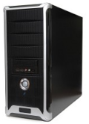
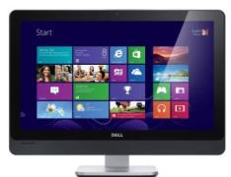
KE8950/8952 Transmitter
LAN

Slide 4
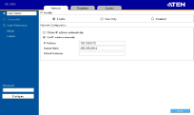
KE8950/8952 Receiver
LAN

Slide 5
HDMI Amazing Video 4K Resolution
1 HDMI Inputs up to 3840 x 2160 @30HZ 4:4:4

Slide 6
SFP optical module
10km
SFP optical module
transmission distance up to
Multi-Mode module 2A-136G 550m
Single-Mode module 2A-137G 10km

Slide 7
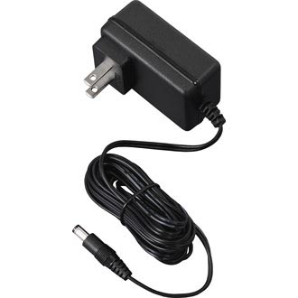
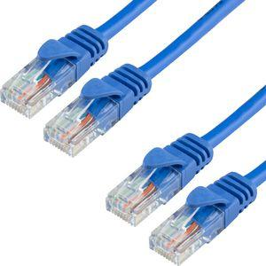
PoE
comply with 802.3at

Slide 8
KE Series Comparison
Model | KE6900ST | KE6900 | KE6940 | KE8950 | KE8952
Video Resolution | DVI-D | DVI-I | 2*DVI-I | HDMI | HDMI
 | 1920*1200@60Hz | 1920*1200@60Hz | 1920*1200@60Hz | 3840*2160 @30Hz | 3840*2160 @30Hz
HDCP | N | N | N | 1.4 | 1.4
Audio | N | Y | Y | Y | Y
Mouse Emulation | Y | Y | Y | Y | Y
Tx Local Console | N | Y | Y | Y | Y
Fast Switching | Y | Y | Y | Y | Y
Dual Video Interface | N | N | Y | N | N
Mixed sources | Y | Y | Y | Y | Y
Video Wall | Y | Y | Y | Y | Y
RS-232 | Y | Y | Y | Y | Y
OSD | N | Y | Y | Y | Y
Virtual media | Y | Y | Y | Y | Y
Virtual USB | N | Y | Y | Y | Y
PoE | N | N | N | N | Y
LAN | 1 Gbps | 1 Gbps | 1 Gbps | 1 Gbps | 1 Gbps
SFP | N | N | N | Y SM to 10km MM to 550m | Y SM to 10km MM to 550m
IR control | N | N | N | N | N
Cable included | DVI-D USB (TX) | DVI-D USB (TX) | DVI-D USB(TX) | HDMI-USB(TX) | HDMI USB(TX) No power adapter
MSRP(1T or 1R ) | $699 | $1,099 | $1,499 | $1,645 MM fiber $95 SM fiber $175 | $1,795 MM fiber $95 SM fiber $175

Slide 9
What makes KE Series Different?

Slide 10
Configuration Flexibility
Receiver Local OSD
RS-232 or Telnet
CCKM Matrix Manager
Multiple Ways for Configuration
Notes:
先講總共有哪些config方式做總結

Slide 11
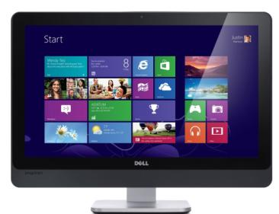
Configuration – Receiver Local OSD
Receiver Local OSD
Notes:
先講總共有哪些config方式做總結

Slide 12
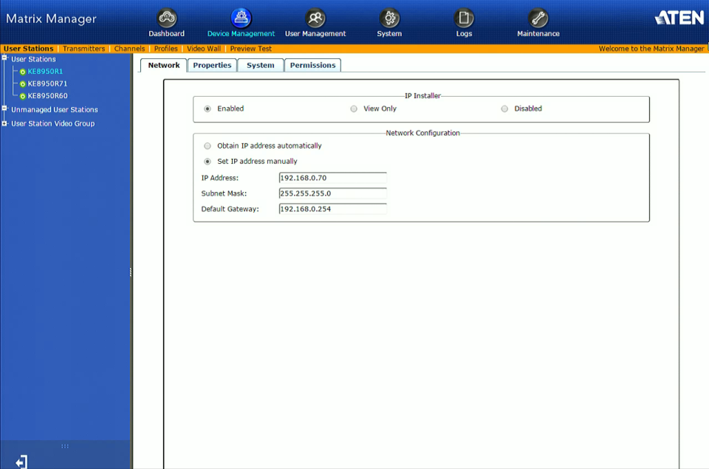
Configuration Flexibility – Matrix Manager
Through Matrix Manager

Slide 13
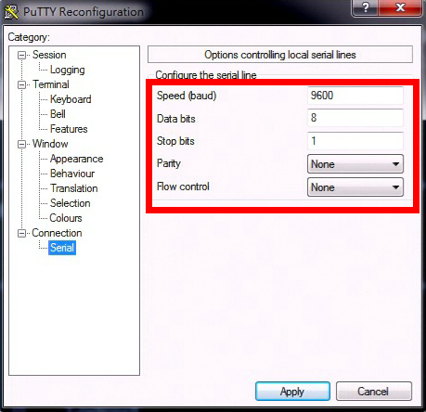
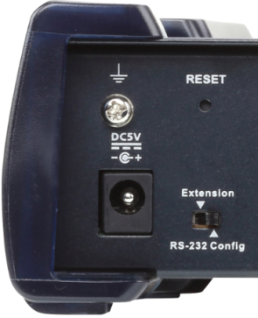
Configuration Flexibility – RS232
Text Menu through RS232
*Don’t forget to switch to RS-232 Config setting

Slide 14
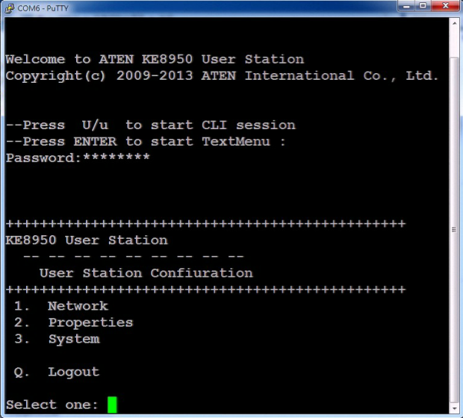
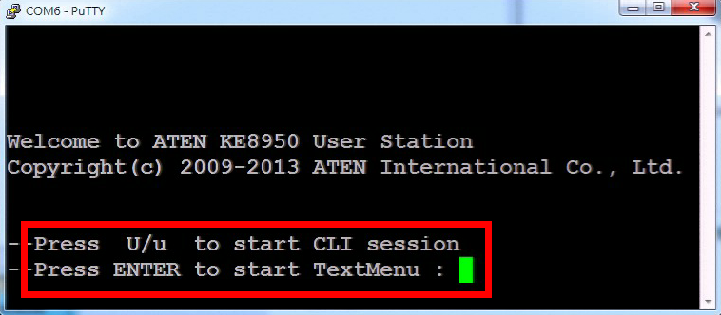
Configuration Flexibility – RS232
Text Menu through RS232

Slide 15
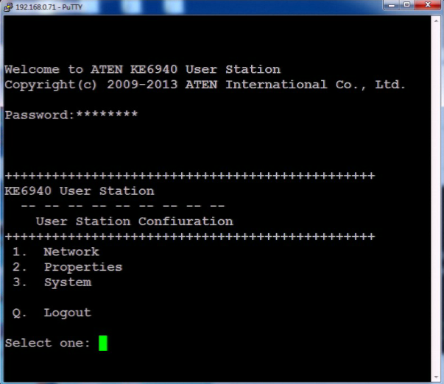
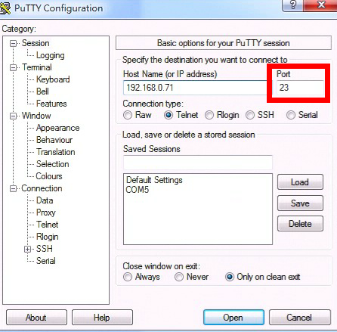
Configuration Flexibility - Telnet
Through Telnet port 23

Slide 16
KE8900/8952 Transmitter Local Console
Whew~~
I am on it
Local console => Emergency operation

Slide 17
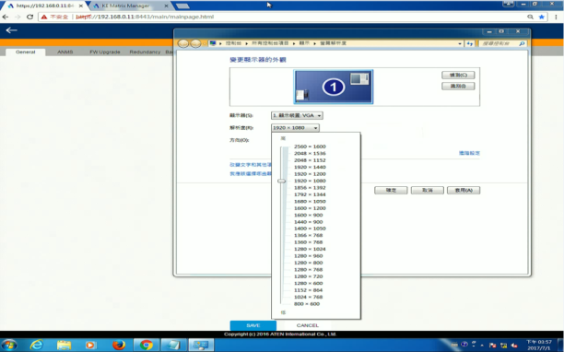
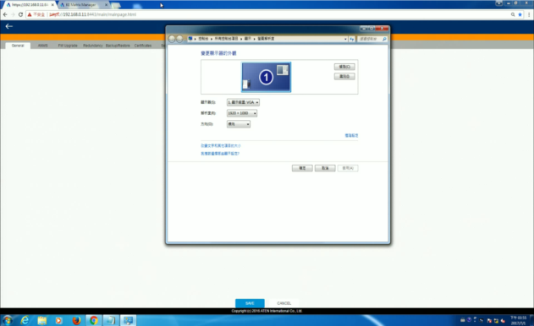
Fast Switching
Why it takes
that long?
Resolution 1280 x 1024
Resolution 1920 x 1080
Blank

Slide 18
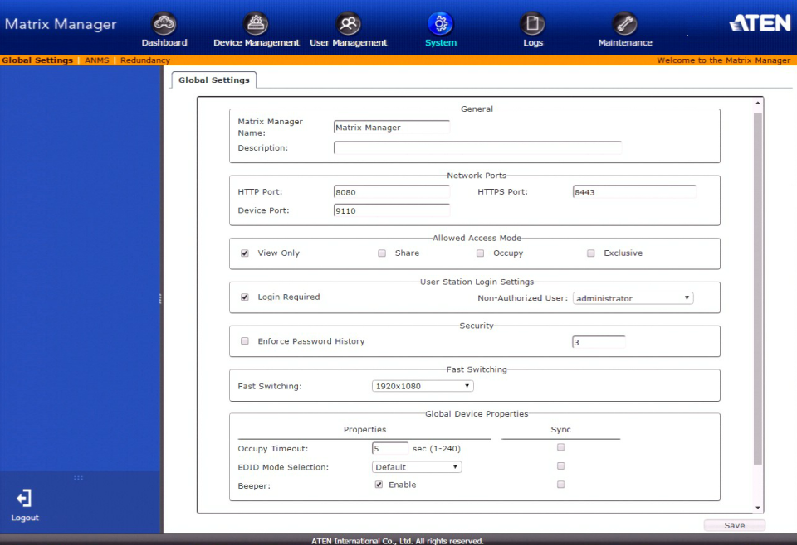
Fast Switching

Slide 19
Fast Switching
Resolution 1280 x 1024
Resolution 1920 x 1080

Slide 20
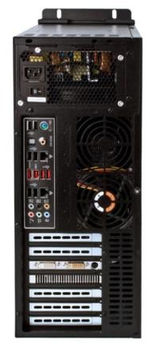
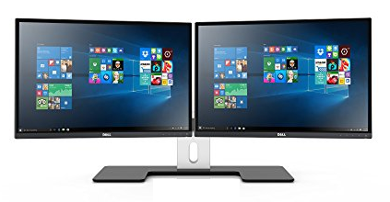
Multi Display
LAN

Slide 21
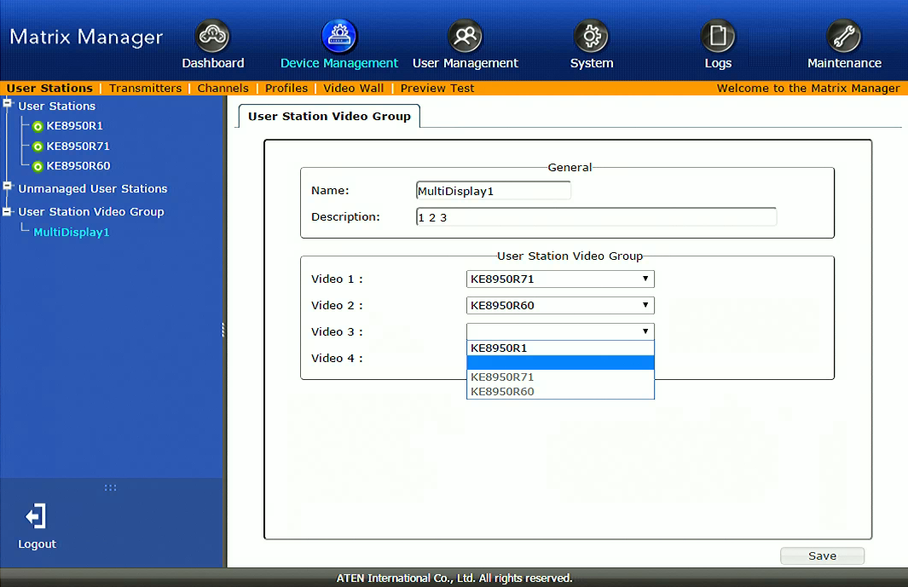
Multi Display
Add a Video Group

Slide 22
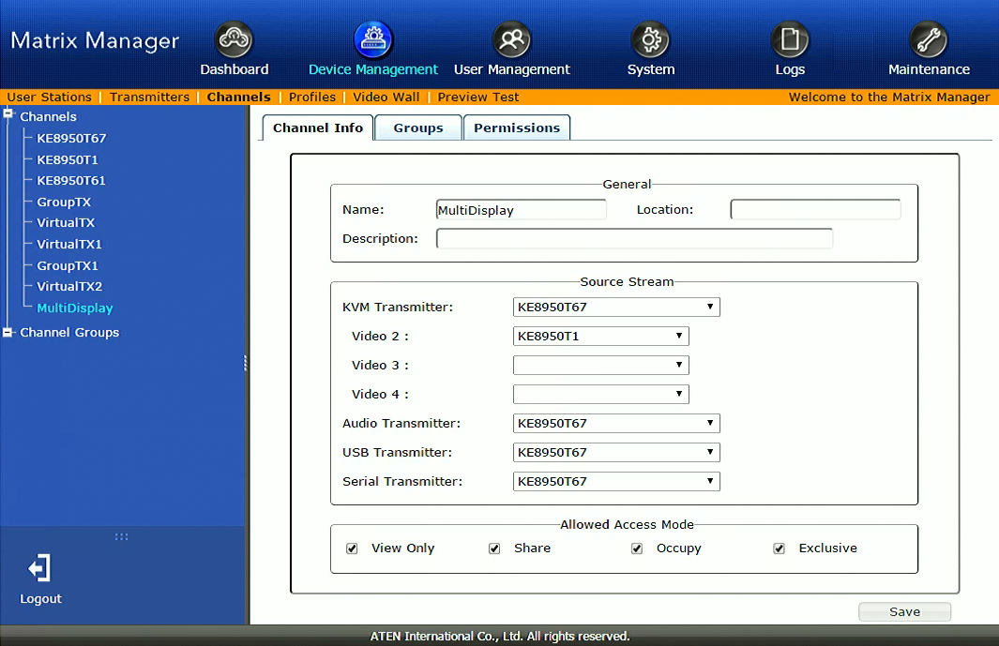
Multi Display
Create a new Channel and setup Video/Audio/USB/Serial Source from Transmitters

Slide 23
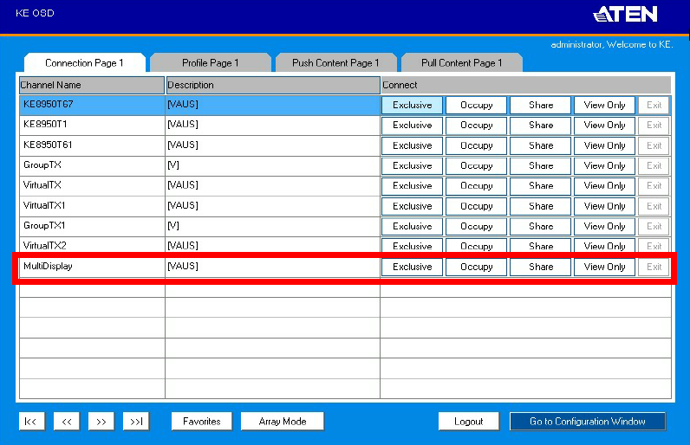
Multi Display
Login KE Receiver and Click MultiDisplay Channel

Slide 24
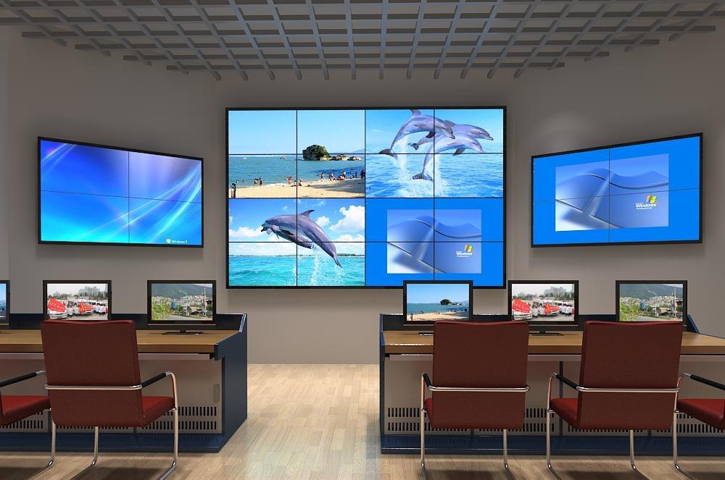
VideoWall

Slide 25
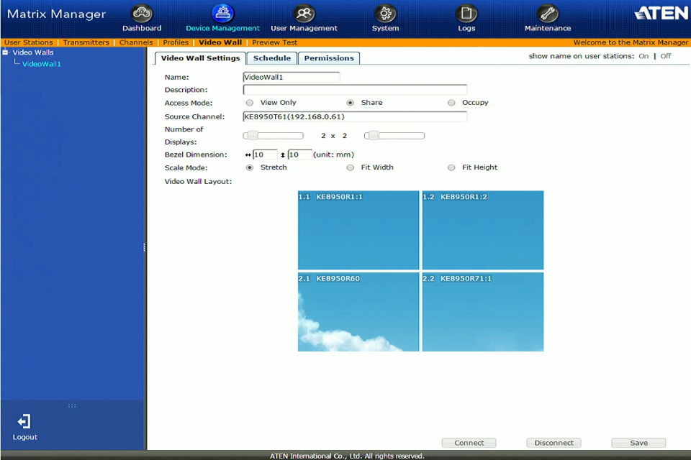
VideoWall
Device Management -> Video Wall

Slide 26
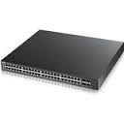
VideoWall
KE takes advantage of multicasting packets. When network switch receives packets, it simultaneously sends them to all selected KE devices.
Scaling
KE8950R
Multicasting
Scaling
GbE Switch
KE8950R
KE8950T
Scaling
Scaling
KE8950R
KE8950R

Slide 27
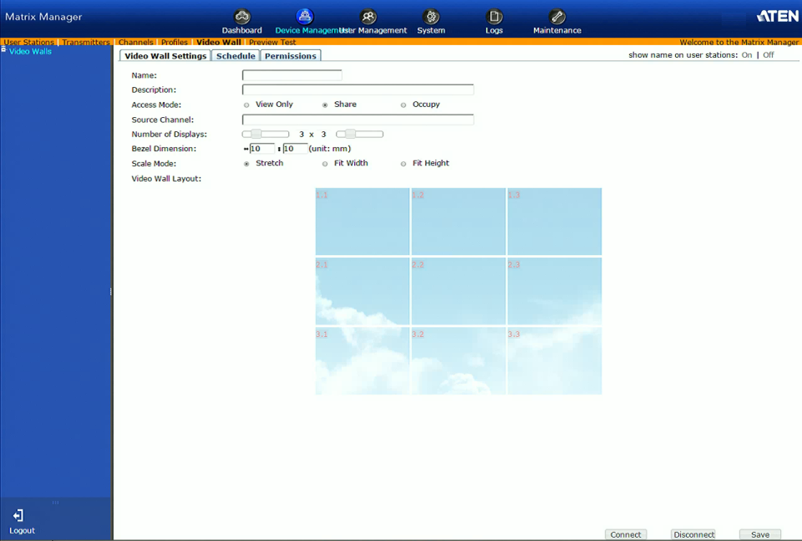
VideoWall Scheduling
27
Notes:
27

Slide 28
Advance Security
AES-128 bit Encryption on Video/KB/MS/USB Data

Slide 29
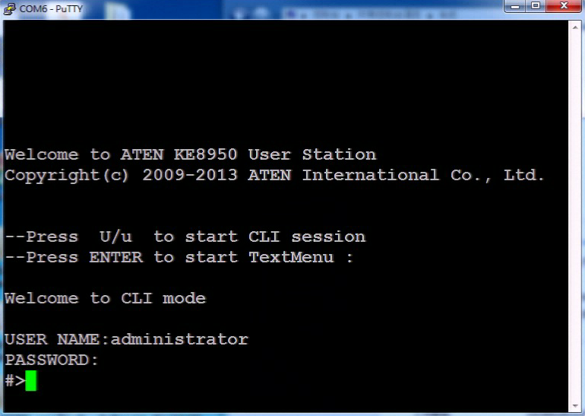
Command Line Interface
CLI through RS-232

Slide 30
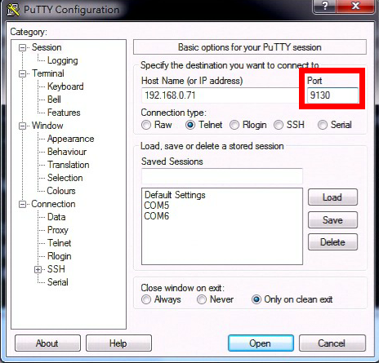
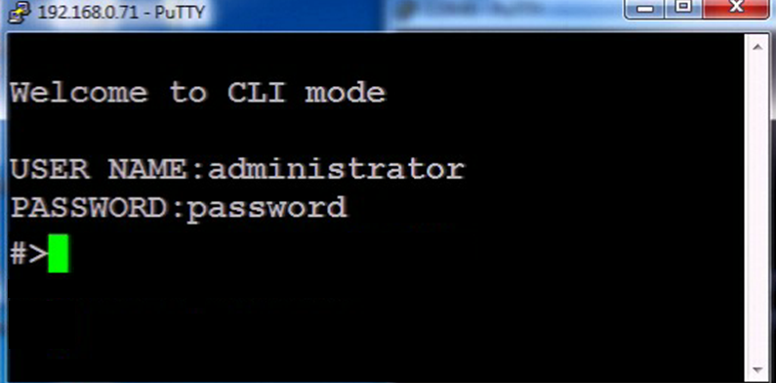
Command Line Interface
CLI through Telnet port 9130

Slide 31
Deep Color
36-bit Deep Color Support

Slide 32
KE’s Versatility
RX
RX
RX
RX
RX
RX
RX
RX
RX
Console
TX
TX
TX
TX
TX
TX
TX
TX
TX
PC
KVM Switch
Computer Sharing Device
Matrix
Extender

Slide 33
KE Matrix System
CCKM

Slide 34
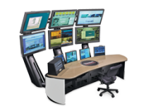
KE Matrix System Topology
CCKM
Individual console
Location A
…
…
.…
Panel Array mode up to 6 x 6
Network Switch
Multi-display Rx 4 units
Location B
…
…
.…
Video wall Rx 8 units
…

Slide 35
Unlimited Transmitters Receivers Combination
Receiver Scale
Combination Scale out
n
…
+
…
m
n
…
2
+
1
+
Transmitter Scale
1
2
…
m
Notes:
下面加m Tx * n Rx

Slide 36
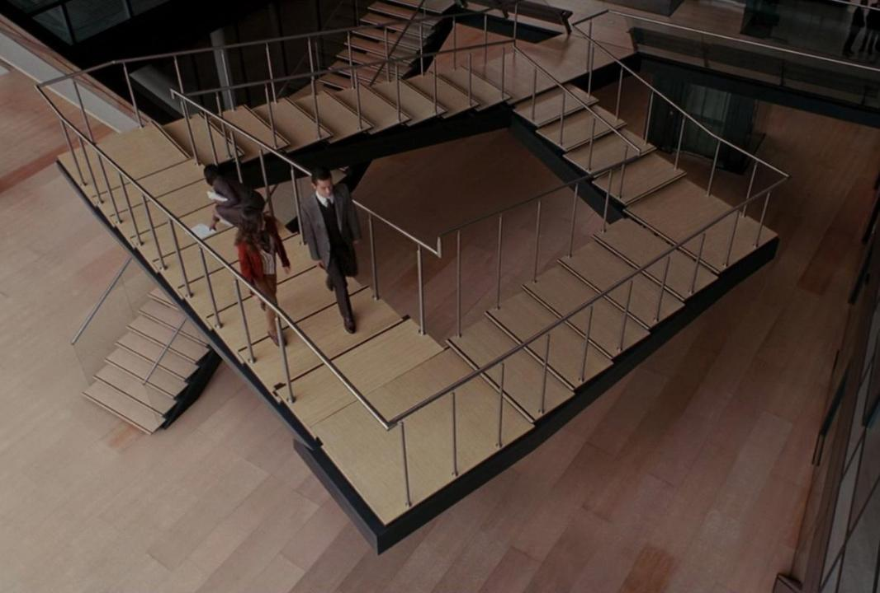
No Distance Restriction beyond your imagination
Notes:
再加一張總結數量跟距離都是Unlimited做總結

Slide 37
Virtual Transmitter(Channel)
Virtual Transmitter => Video, Audio, USB, RS232 from different Transmitter
Video
Audio
USB
RS232
6900ST
KE8900T1
KE8900T2
KE6900T
LAN
CCKM
Virtual T1 (Video + USB)
Virtual T2 (Video + Audio + RS232)
KE8900R
KE6900R

Slide 38
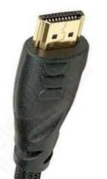
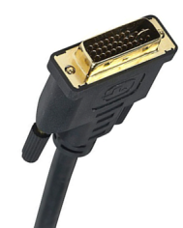
All Video Format Supported
Analog and Digital Video Signal(RGB & YCbCr)

Slide 39
Centralized Management
Primary CCKM
Secondary CCKM
Location A
Control Room A
…
.…
…
Transmitter
Receiver
Network Switch with PoE
Control Room B
Location B
…
…
.…
Receiver
Transmitter

Slide 40
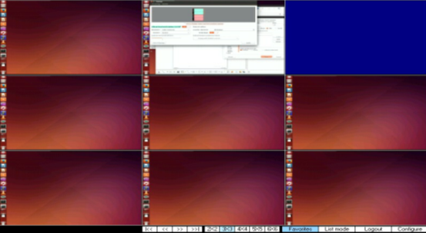
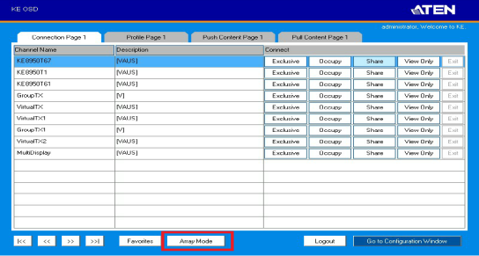
Array Mode
Simultaneously Real-Time Video Preview

Slide 41
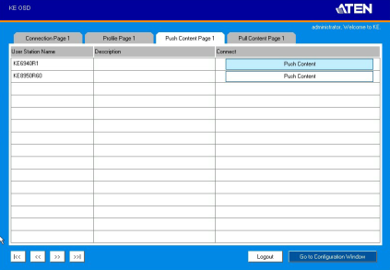
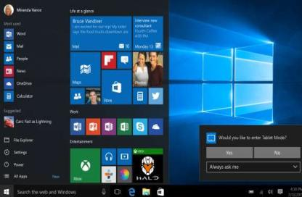
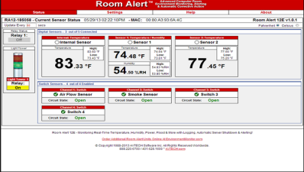
Push & Pull
Push

Slide 42
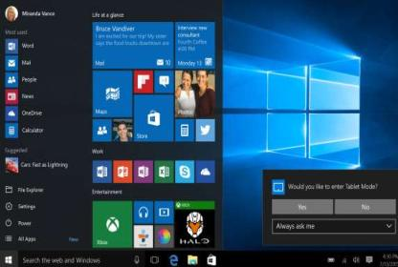
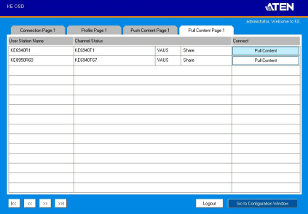
Push & Pull
Pull

Slide 43
KE Series Comparison
Model | ATEN KE8950/KE8952 | Avocent HMX 6000 | ADDER ALIF 2002T/2000R 2112T | Gefen EXT-DVIKVM-LANTX/RX | Gefen EXT-HDKVM-LANTX/RX
Video Resolution | HDMI | DVI-D Dual Link | DVI-D Dual Link | DVI-D | HDMI
 | 3840*2160 @30Hz | 2560*1600@60Hz | 2560*1600@60Hz | 1920*1200 @60Hz | 1920*1200 @60Hz
HDCP | 1.4 | N | Y | N | Y
Audio | Y | Y | Y | Y | Y
Mouse Emulation | Y | Y | Y | Y | Y
TX Local Console | Y | VNC(6210T) | VNC(2112T) | N | N
Fast Switching | Y | Y | Y | N | N
Multi Display | Y | Y | Y | N | N
Video Wall | Y | N | N | N | N
RS-232 | Y | Y | Y | Y | Y
OSD | Y | Y | Y | Y | Y
CLI | Y(RS232 and Telnet) | Y(RS-232) | N | Y(Telnet) | Y(Telnet)
Video Encryption | Y | Y | N | ? | ?
Virtual media | Y | Y | Y | Y | Y
Virtual USB | Y | Y | Y | Y | Y
PoE | N/Y | N | N | N | N
LAN | 1 Gbps | 1 Gbps | 1 Gbps | 1 Gbps | 1 Gbps
SFP | Y SM to 10km MM to 550m | Y SM to 10km MM to 550m | Y SM to 10km MM to 500m | N | N
IR control | N | N | N | Y | Y
MSRP(1T or 1R) | $1,645/$1795 MM fiber $95 SM fiber $175 | 6200 $1645 6210 $1845 MM fiber $100 SM fiber $185 | 2002 $1550 2112T $1750 MM fiber $95 SM fiber $175 | Tx $499 Rx $429 | Tx $579 Rx $449

Slide 44
Application
What kind of application is a fit for KE Series?

Slide 45
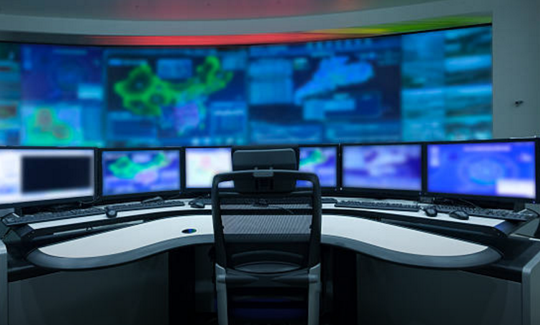
Any Application related to Control is a fit for KE

Slide 46
KE Matrix System Application
Traffic Management Centers
Retail Surveillance Centers
Facility Situation Rooms

Slide 47
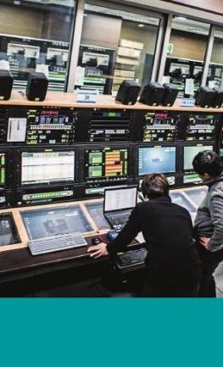
KE Matrix System Application
Command Control Centers
Utilities Process Control Centers
Broadcasting Distribution Monitoring Systems

Slide 48
KE Matrix System Application
Network Operation Center (NOC)
Network Operation Center

Slide 49
KE Matrix System Application - NOC
NOC in a Data Center
Building Site
Data Center
Network Operation Center (NOC) is one or more locations where NOC engineers are on duties to ensure the smooth running and operation of the data center
NOC is a type of control room typically for data center
Secure Entrance, General Office Space & Common Areas
Entrance Room(s)
Support Staff Offices
Electrical Room(s)
Network Operation Center
Telecommunications Room(s)
Mechanical Room(s)
Computer Room
Figure: Relationship of spaces in a data center, ANSI/TIA-942

Slide 50
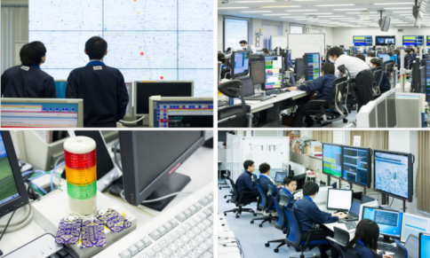
KE Matrix System Application - NOC
NOC Case - Before
Poor information integration and collaboration Lack of well-arranged large videowalls for collaboration and information integration.
Less operation efficiency Various equipments and displays scattered around console desks reduced operator’s efficiency
Poor ergonomics Operators were also distracted by heat and noise by different computers/devices

Slide 51
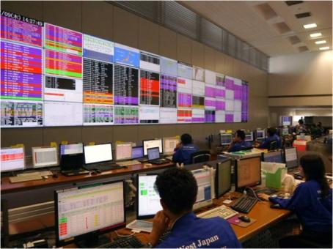
KE Matrix System Application - NOC
NOC Case - Later
Improved collaboration and decision making Large videowalls improved information integration and enabled better collaboration. All the information was better displayed and shared.
Short of operation efficiency Equipment arrangement at each console station to be improved for better operation efficiency

Slide 52
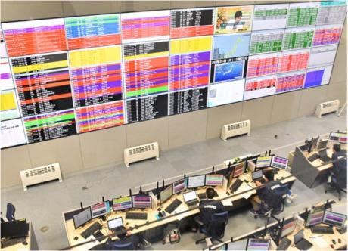
KE Matrix System Application - NOC
NOC Case - NOW
Better collaboration and decision making Large videowalls improved information integration and enabled better collaboration and decision making.
Improved operation efficiency Unified and better arranged console displays helped each operator better concentrate and perform his tasks.
Ergonomics for better operation Heat and noise by computers removed from console operators for better operation environment. Computers moved away from NOC can be centrally managed

Slide 53
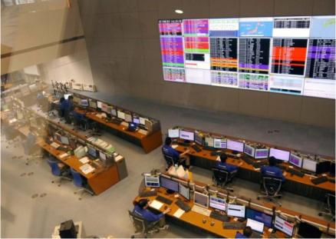
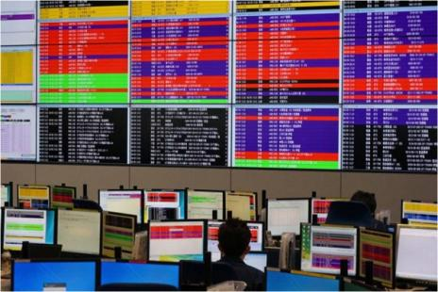
KE Matrix System Application - NOC
NOC Case – Cont’d

Slide 54
Why is KE8950 a good fit for any Control Room?
Extremely high frame rate to ensure operation without latency
Virtual USB can bypass USB signal directly to Tx in case of any compatibility issues.
Severe access control - Admin, Super User, User
Video/KB/MS/Data Encryption for Security

Slide 55
Q&A

Slide 56
FAQ
What are the main features of KE89 Series other than KE69 Series?
4K 3840 x 2160 @30Hz (4:4:4)
SFP port for optical Network
SFP
Power over Ethernet

Slide 57
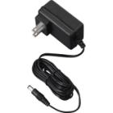
FAQ
What is the difference between KE8950 and KE8952 ?
PoE
KE8952 does NOT come with Power Adapter

Slide 58
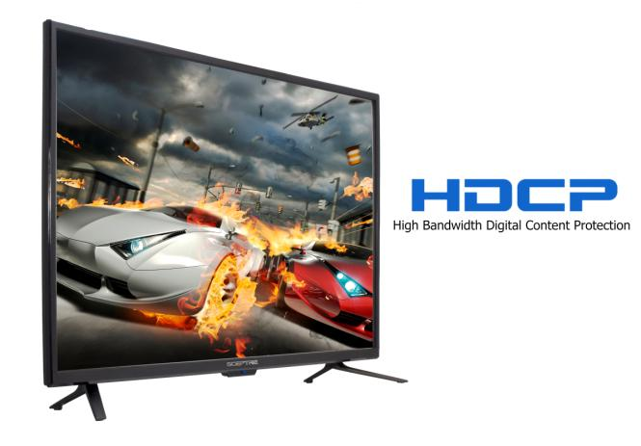
FAQ
What is the HDCP version KE89 supports?
1.4

Slide 59
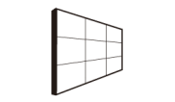
FAQ
What is the Strength of KE89 Series compared to our competitors?
Configuration Flexibility
Transmitter Local Console
Fast Switching
Multi Display
Video Wall
Deep Color 36-Bit

Slide 60
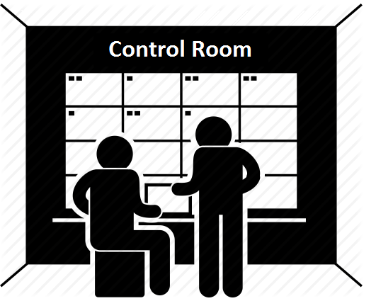
FAQ
What is the best application for KE ?

Slide 61
Q&A

Slide 62
Q&A
What are the main features of KE89 Series other than KE69 Series?
DVI Dual Link 2560 x 1600
HDMI 4K 3840 x 2160 @30Hz (4:4:4)
SFP Port
PoE
Distance up to 50m

Slide 63
Q&A
What is the difference between KE8950 and KE8952 ?
DVI Dual Link 2560 x 1600
HDMI 4K 3840 x 2160 @30Hz (4:4:4)
SFP Port
PoE
Distance up to 50m

Slide 64
Q&A
What is the HDCP version KE89 supports?
1.1
1.4
2.2

Slide 65
Q&A
What is the Strength of KE89 Series compared to our competitors?
Configuration Flexibility
Transmitter Local Console
Fast Switching
Multi Display
Video Wall
Deep Color 36-Bit
All

Slide 66
Q&A
What is the best application for KE ?
Smart Home
Shopping Mall
Control Room

Slide 68
Appendix: Fiber Module 2A-136G 2A-137G Spec
 | 2A-136G | 2A-137G
Data Rate | 0.8-1.5 Gbps | 0.8-1.5 Gbps
Supply Current | 300mA | 300mA
Power Dissipation | 1000mW | 1000mW
Supported Link Length on 50/125μm MMF | 550m | N/A
Supported Link Length on 9/125μm SMF | N/A | 10km

Slide 69
Appendix: Bandwidth
Model | KE8950 | Environment
Firmware | V1.0.094
1920x1080@60 1T / 1R Matrix Mode | 12~20 | Low (Office) Bandwidth Observation of GigaSwitch unit: (Mbps)
1920x1080@60 1T / 1R Matrix Mode | 24~64 | Normal (Web-browse) Bandwidth Observation of GigaSwitch unit: (Mbps)
1920x1080@60 1T / 1R Matrix Mode | 160~245 | High (Web-browse+Half Screen Movie) Bandwidth Observation of GigaSwitch unit: (Mbps)
1920x1080@60 1T / 1R Matrix Mode | 440~520 | Ultra High (Full Screen Movie) Bandwidth Observation of GigaSwitch unit: (Mbps)

Slide 70
Appendix: Bandwidth
Model | KE8950 | Environment
Firmware | V1.4.134
3840x2160@60 1T / 1R Matrix Mode | 16 | Low (Office) Bandwidth Observation of GigaSwitch unit: (Mbps)
3840x2160@60 1T / 1R Matrix Mode | 32 | Normal (Web-browse) Bandwidth Observation of GigaSwitch unit: (Mbps)
3840x2160@60 1T / 1R Matrix Mode | 400 | High (Web-browse+Half Screen Movie) Bandwidth Observation of GigaSwitch unit: (Mbps)
3840x2160@60 1T / 1R Matrix Mode | 840 | Ultra High (Full Screen Movie) Bandwidth Observation of GigaSwitch unit: (Mbps)

