Slide 1

UH3231 Product Guide
USB-C Dual-View Mini Dock
Product Manager: Ethan Yu
SOHO Solution Dept.
本文件未經許可不得任意轉載、披露。
This file contains information that is for sole use of the intended recipient and may be confidential or privileged. ANY UNAUTHORIZED REVIEW, COPYING, DISCLOSURE, USE OR DISTRIBUTION IS STRICTLY PROHIBITED.

Slide 2
Outline
What is the UH3231
Product Feature, Advantage and Benefit
Product Applications & Comparison
Package Content & Order Information
FAQ

Slide 3
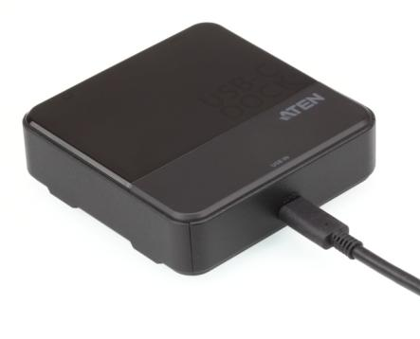
UH3231 – Freeway for Data Transmission
Product description: USB-C Dual-View Mini Dock
MSRP: USD99.9/EURO99.9
Prelim Specification
  Up to 5Gbps data throughput via USB3.1 Gen1 technology
  Enable two DisplayPort monitors working simultaneously with video mirror or extension mode maximum output up to 1080p*,and single DisplayPort maximum output up to 3840x2160@30Hz under Windows Platform
  Compatible with DisplayPort™ v1.2, HDCP1.3 and DisplayPort™ Dual Mode
  Compatible with Macbook 2016 /2015*
  Supports kinds of Active DisplayPort adapters converting to HDMI, DVI, or VGA output connectivity.
  Integrated 1-port USB 3.1 Gen1 hub
  Driver Free, USB bus powered, Plug & Play without configuration
  1m USB-C certified (20V/5A) cable included
  *The Mac computer only support single-view video output

Slide 4

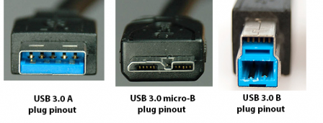
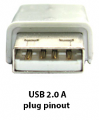
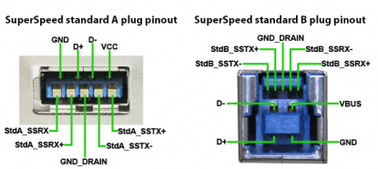
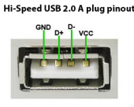
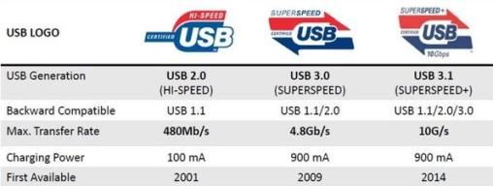
USB Type C ? USB 3.1 ?
USB Type C
USB 3.1
USB Type C =Name of connector specification
USB 3.1=Universal Serial Bus 3.1
USB3.0 changed name to USB3.1 Gen1
,which means USB3.0=USB3.1 Gen1
Data Transfer Speed
USB3.1 Gen1=5Gb/s
USB3.1 Gen2=10Gb/s
x

Slide 5
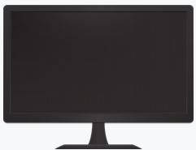
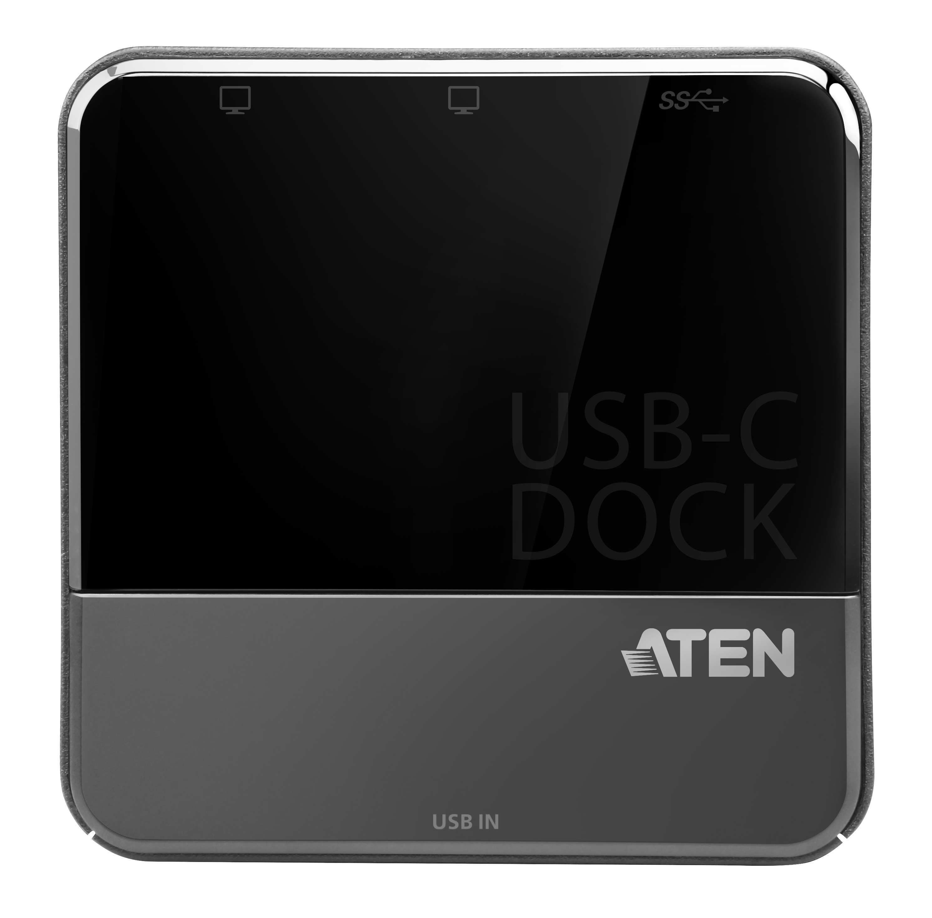
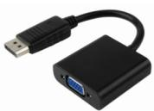
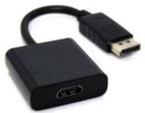
DisplayPort Dual Mode(DP++)
The DisplayPort Dual-mode (DP++) is designed to transmit a DVI or HDMI 1.2/1.4
protocol across the interface through the use of an external passive adapter.
Analog VGA and dual-link DVI require powered active adapters to convert the protocol and signal levels.
The UH3231 mini dock has DisplayPort Dual Mode(DP++) certification , which
means either the passive adapters or the active adapters can be used to connect to monitor.
DisplayPort to VGA Adapter
(active)
VGA
Monitor
UH3231
Mini Dock
+
DisplayPort to HDMI Adapter
(passive)
HDMI
Monitor
USB 3.1 Gen1 TypeA Flash*1

Slide 6
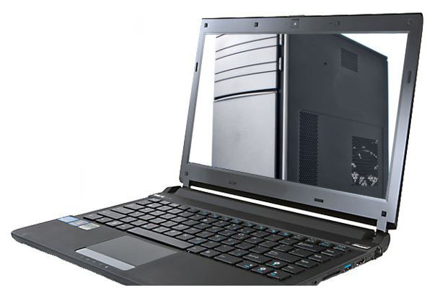

Why should I need a Docking Station?
There’s no way to get all of the advantages of a desktop and laptop without buying two computers.
But if you’re willing to make a few compromises, you get something close to your needs and desires.
One solution—a laptop with a docking station. Typically, when you plug the laptop into device, you get USB port, one or more video connections.
Volume sizes: Saves work space, and easy to carry.
Easy to install with plug-and-play convenience. No additional drivers required.

Slide 7
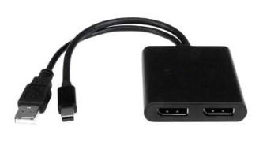
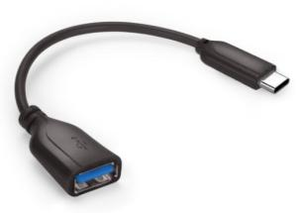
Product Features, Advantages and Benefits
The UH3231 mini dock provide function just like MST(multi stream transport)Hub + USB Type-C to Type A dongle.
2 DisplayPort video output add usability and possibilities.
Add 1 USB 3.1 Gen1 Type1 device to use.
Supported DisplayPort Dual Mode(DP++)
DisplayPort Dual Mode(DP++) certificated
DisplayPort Alt mode certificated
+
=
UH3231
Mini Dock
2 ports MST Hub
USB Type-C to Type A dongle

Slide 8
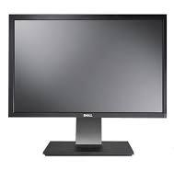



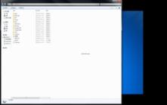
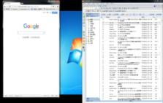
Connection Diagram - DP1.2 MST(Multi-Stream Transport)Mode
USB 3.1 Gen1 TypeA Flash*1
UH3231
Mirror Mode
Type C
DP Display
DP Display
Maximum output up to 1080p@60Hz
in Dual Display
Video
USB 3.1 Gen1 TypeA Flash*1
Data
UH3231
Extend Mode
Type C
DP Display
DP Display

Slide 9
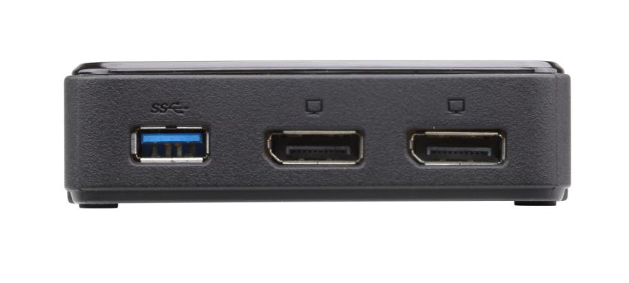
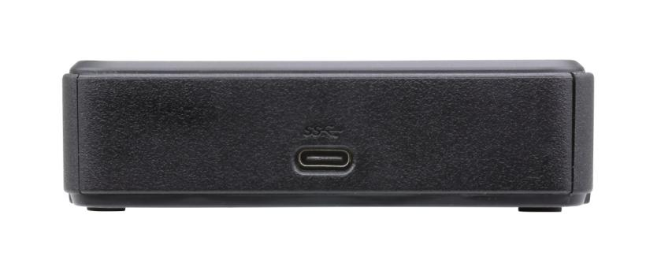
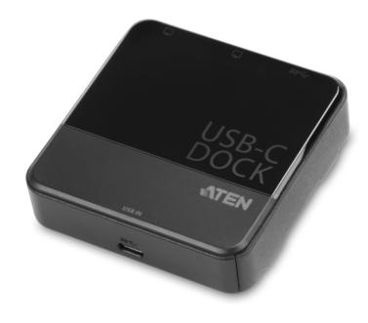
UH3231 Front/Rear View
UH3231
Front
2
1
Rear
3
1. DisplayPort video Port
2. USB 3.1 Gen1 Type-A Port
3. USB-C Port

Slide 10
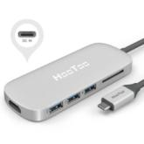
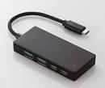



Product Comparison
(with docking station category)
Brand | ATEN | Elxxom | Elxxom | HooToo | Stxxxxxh | Dxll
Model Name | UH3231 | U3HC-A412BBK | U3HC-DC03BBK | HT-UC001 | DKT30CHV | 4W2HW
Image
Interface | USB-C | USB-C | USB-C | USB-C | USB-C | USB-C
 | Gen1 | Gen1 | Gen1 | Gen1 | Gen1 | Gen1
Video Interface | DP ++x2 | 0 | HDMIx1 | HDMIx1 | HDMI x1 VGA x1 | HDMI x1 mDP x1 VGA X1
Max. Video output | 2 | NA | 1 | 1 | 1 | 2
Max. 4k@30 video output | 1, DPx1 | NA | 1, HDMI | 1, HDMI | 1, HDMI | 1, HDMI or mDP
Data transfer | x1 USB3.1 Type-A | x2 USB3.1 Type-C x2 USB3.1Type-A | x3 USB3.1 Type-A | x3 USB3.1 Type-A+SD | x1 USB3.1 Type-A | x3 USB3.1 Type-A x2 USB2.1 Type-A
Ethernet | 0 | 0 | 0 | 0 | 1 | 1
Audio | 0 | 0 | 0 | 0 | 0 | headset+ mic
Case Material | Plastic | Plastic | Plastic | Aluminum alloy | Plastic | Plastic
USB PD support | NA | NA | Yes | Yes | NA | Yes
Power Adapter Required | Bus powered | Bus powered | Optional | Optional | Bus powed | Yes
MSRP | USD99.9 | USD87.9 | USD139.9 | USD99.9 | USD94.9 | USD199.9

Slide 11
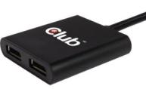
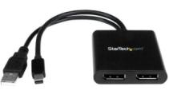
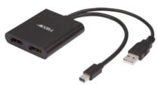
Product Comparison
(with MST Hub category)
Brand | ATEN | Clxx3D | Stxxxxxh | Axxxll
Model Name | UH3231 | CSV-5200 | MSTMDP122DP | xxx
Image
Source Interface | USB 3.1 Gen1 up to 5Gbps | Mini DP | Mini DP | Mini DP
Video output | x2(DP MST mode support) | x2(DP MST mode support) | x2(DP MST mode support) | x2(DP MST mode support)
Data transfer | x1 USB3.1 Gen1 Type-A | 0 | 0 | 0
Case Material | Plastic | Plastic | Plastic | Plastic
Power Adapter Required | Bus powered | Bus powered | Bus powered | Bus powered
MSRP | USD99.9 | USD72.4 (Amazon) | USD60.98 (Amazon) | USD69.89 (Amazon)

Slide 12
UH3231 Package Contents
1 UH3231 USB-C Dual-View Mini Dock
1 1m USB Type-C Cable
1 Quick Start Guide
N. W.:
  UH3231 : 0.18kg , 20 pcs per carton
Dimensions(WxDx H):
UH3231: 9.37 x 9.3 x2.68 cm

Slide 13
Ordering Information
EAN / UPC code
Model Name: UH3231-AT
UPC : 6-72792-00725-5
EAN : 4719264645150

Slide 14
Appendix

Slide 15
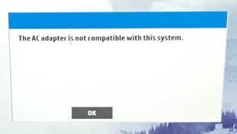
What is a Billboard Device Class?
The USB Billboard Device indicates the failure of Alternate Mode entry. According to USB Type-C specification, if a device fails to successfully enter an Alternate Mode , then the device will minimally expose a USB 2.0 interface (USB Billboard Device Class) that is powered by VBUS to indicate the failure of Alternate Mode entry. The host then reports that an unsupported device has been connected, identifying the type of device from the USB Billboard Device Class information.
Billboard error messages
If a user connects a USB Type-C alternate mode device or adapter that is not supported by the attached HOST, the device or adapter can expose a Billboard device that contains information about the error condition to help the user troubleshoot issues.

Slide 16
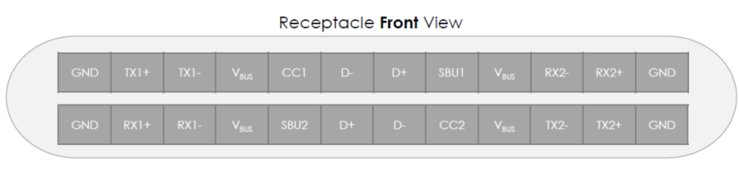
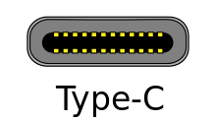
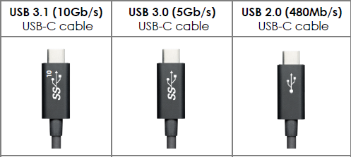
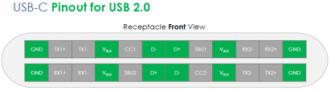
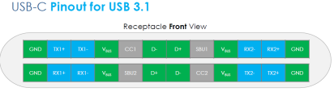
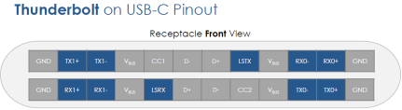

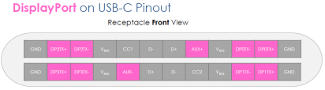
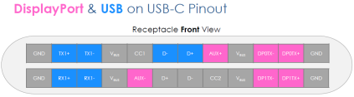
USB Connectors and Pin-out - USB-C
Thunderbolt3
USB Type-C

Slide 17
USB 3.1 Gen1 Performance
Max. Throughput MB/S
2750MB/s
Multi-Media | MP3 | JPEG | DVD | Blu-Ray DVD
Avg. Volume | 5MB | 10MB | 8GB | 50GB
Transmission By USB2.0 | 0.16 Sec. | 0.33 Sec. | 4Min 26.66Sec. | 27Min 46.66 Sec.
Transmission By USB3.0/3.1Gen1 | 0.01 Sec. | 0.03 Sec. | 26.66Sec. | 2Min 46.66 Sec.
1375MB/s
800MB/s
400MB/s

Slide 18

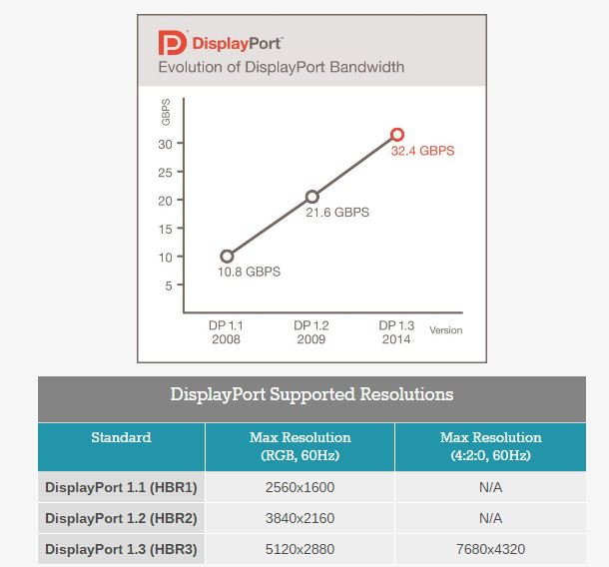

DisplayPort Version Over View

Slide 19

本文件未經許可不得任意轉載、披露。
This file contains information that is for sole use of the intended recipient and may be confidential or privileged. ANY UNAUTHORIZED REVIEW, COPYING, DISCLOSURE, USE OR DISTRIBUTION IS STRICTLY PROHIBITED.

