Slide 1
VM0808HA & VM0404HA Migration
8x8 & 4x4 4K HDMI Matrix Switch
Applied Video Solution Department / Sophia Lai
2016, April

Slide 2
Outlook change
Discrete button for each input and output, allowing for simple, intuitive operation
Illuminated keypad clearly indicate the connection status
Front panel security key lockout preventing erroneous touch
VM0808HA
VM0808H

Slide 3
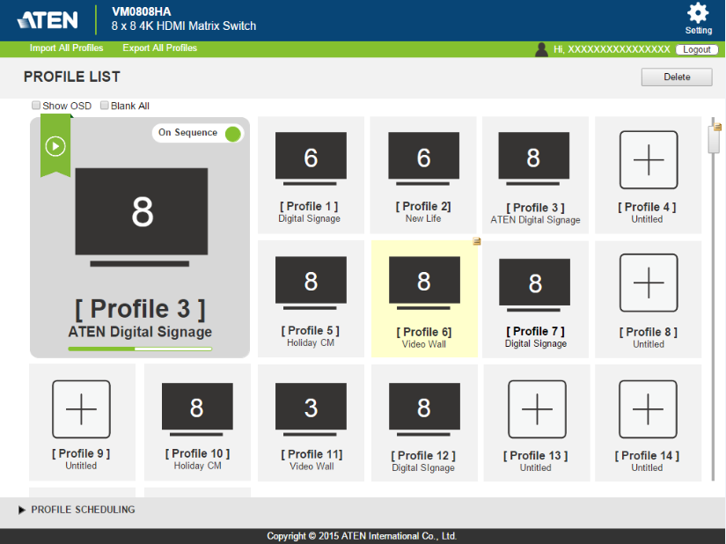
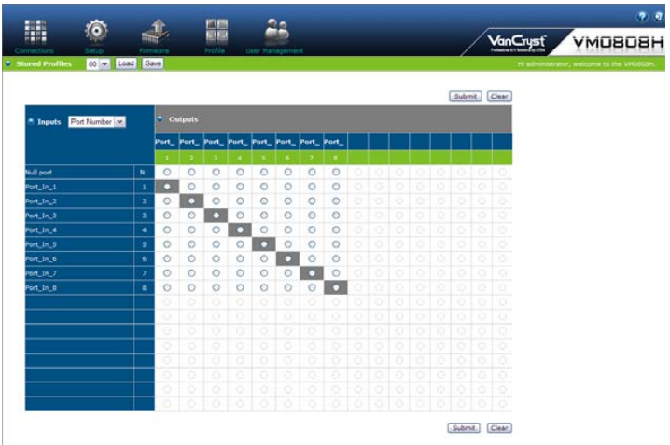
Reddot Award Winning Graphical Design
Intuitive graphical design spot out the key message
Scheduling allows you to queue your own playing list

Slide 4
4K ULTRA HD offers a superb image quality
With four times the resolution of Full HD, you will see the finest details portrayed with the utmost clarity
Supports 4K resolutions of UHD (3840x2160) and DCI (4096x2160) with refresh rates of 30 Hz (4:4:4) and 60 Hz (4:2:0)
Full HD

Slide 5
HDCP 2.2 Ready for 4K Era
Version 2.2 is the latest, designed specifically to prevent illegal copying of 4K Ultra HD content
HDCP 2.2 is not backward-compatible when it comes to 4K video
OK
1080p content HDCP1.4
HDCP2.2 Display
4K content HDCP2.2
HDCP1.4 Display
VM0808HA only

Slide 6
Switch Port in the Blink of an Eye
Instant switch allows you to change your input source within 1~2 sec.
4s
1s

Slide 7
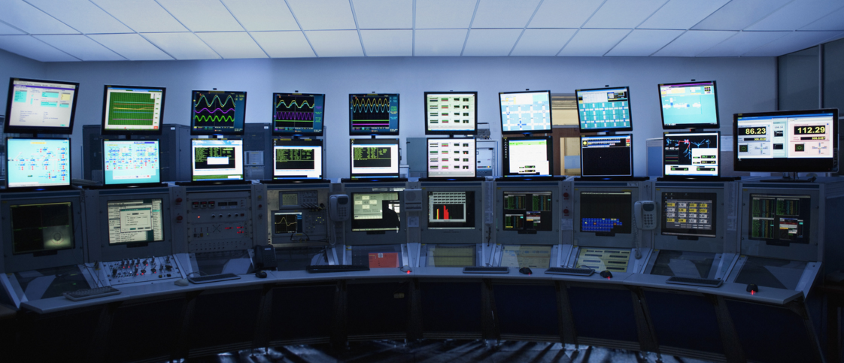
Applications
the VM0808HA/VM0404HA is ideal for applications where the routing of up to 4K digital video signals is required, such as in classrooms, auditoriums, and department stores

Slide 8
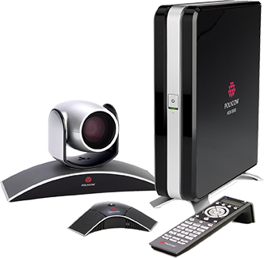
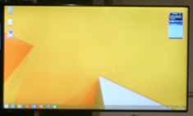
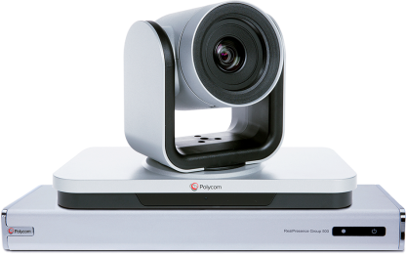
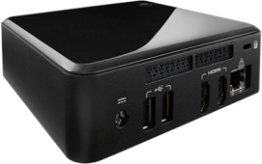
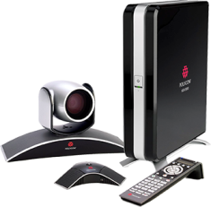
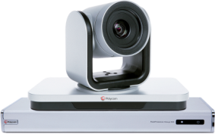
Princeton Video Conference Room
Fixed Devices
Own Devices from attendees
RPG 500
RPG 500 Primary & Secondary Videos
HDX 8000
HDX 8000 Primary & Secondary Videos
Tidebreak
Tidebreak Computer
Laptop & Tablet
INPUT③＆④
INPUT⑤
INPUT①＆②
INPUT⑥
ATEN 8x8 4K HDMI Matrix
OUTPUT①
OUTPUT④
OUTPUT②
OUTPUT③
Display I(Left Side）
Display II(Right Side）
RPG 500
RPG 500 Video Input
(to Remote Site)
HDX 8000
HDX 8000 Video Input
(to Remote Site)

Slide 9
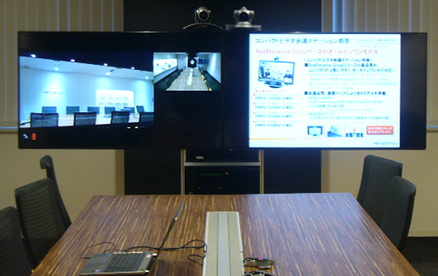
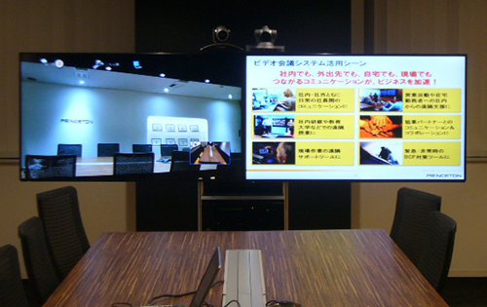
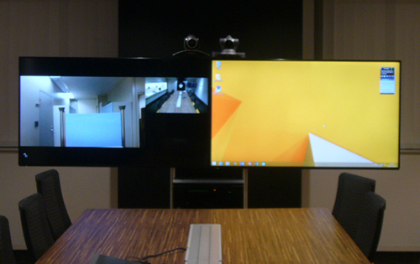
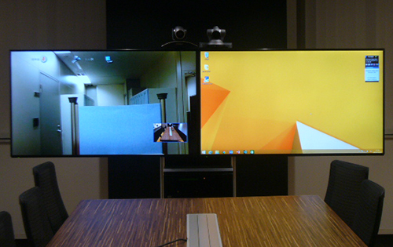
Scenario In Dual Output
PROFILE1: RPG + Own Computer
PROFILE3: HDX + Own Computer
PROFILE2: RPG + Tidebreak Computer
PROFILE4: HDX + Tidebreak Computer

Slide 10
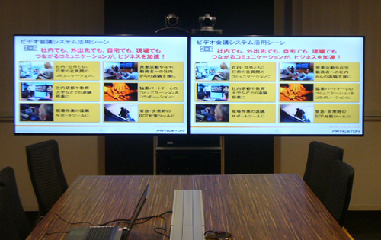
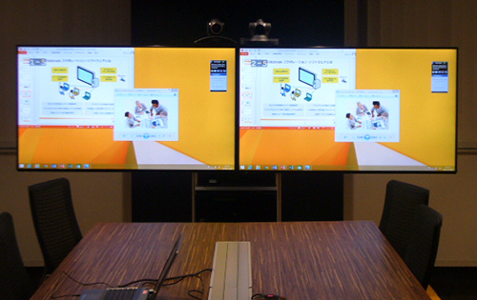
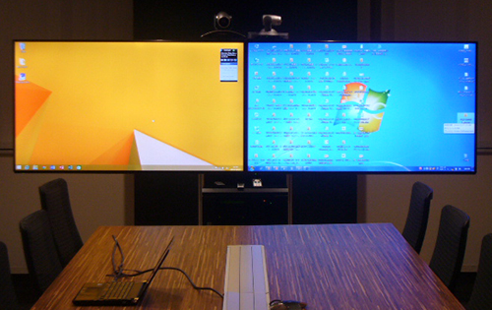
Scenario in Mirror Display
PROFILE5:
PROFILE6:
PROFILE7:
Mirrored Display of
Own Computer
Mirrored Display of
Tidebreak Computer
Tidebreak Computer +
Own Computer

Slide 11
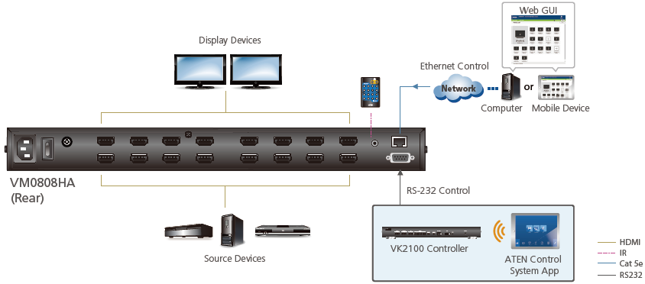
VM0808HA & VM0404HA Featured
Connects any of 8 HDMI sources to any of 8 HDMI displays
Supports 4K resolutions of UHD (3840x2160) and DCI (4096x2160) with refresh rates of 30 Hz (4:4:4) and 60Hz (4:2:0)
HDCP 2.2 compliant (VM0808HA only)
EDID Expert™ – selects optimum EDID settings for smooth power-up, high-quality display, and use of the best video resolution across different screens
Multiple Control Methods – system management via front-panel pushbuttons, IR, RS-232, and Ethernet (WebGUI) connections (VM0808HA only)

Slide 12
FAQ: Phase In Method
VM0808H & VM0404H will be EOL and replaced with VM0808HA & VM0404HA
Replacement will be base on Running Change

Slide 13
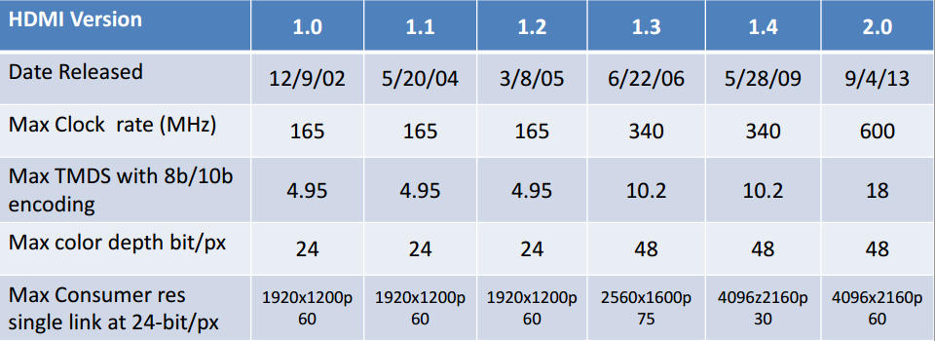
FAQ: IS VM0808HA supporting HDMI 2.0? What’s the bandwidth ?
4K@60, 4:2:0 was first introduced in HDMI 2.0 specification
VM0808HA supporting 4K@30, 4:4:4 & 4K@60, 4:2:0 with max bandwidth in 10.2Gbps

