Slide 1

US234/US434 Product Guide
2/4-Port USB 3.0 Peripheral Sharing Device
SOHO Solution Dept.
本文件未經許可不得任意轉載、披露。
This file contains information that is for sole use of the intended recipient and may be confidential or privileged. ANY UNAUTHORIZED REVIEW, COPYING, DISCLOSURE, USE OR DISTRIBUTION IS STRICTLY PROHIBITED.

Slide 2
Outline
What is the US234/US434
USB Overview
Product Feature, Advantage and Benefit
Product Applications & Comparison
Package Content & Order Information
FAQ

Slide 3
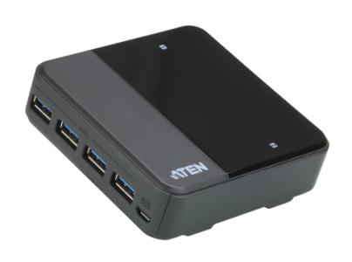
US234/US434 – Freeway for Data Transmission
Product description: 2/4-port USB 3.0 Sharing Switch
MSRP: USD $69.99/94.99
Specification
  Up to 5Gbps data throughput via USB 3.0 technology
  2/4 port (UFP) USB switch with 4 horizontal USB 3.0 Port (DFP)
  Compatible with PC & Mac
  Suitable for desktop control and peripheral sharing in multiple computer environments
  Remote control
  Detachable Cable, length: 1.2M/1.8M

Slide 4





USB 3.0 promises a major leap forward in transfer speeds and capability
Legacy product
USB 3.0
Benefits
USB Graphic Card
HD/UHD Video Output
USB HDD
Standalone/RAID Storage
USB Flash
High speed Flash/SSD
USB Card Reader
Access High Capacity CF/SD/MS/Others
USB Hub/Hub IC
Other USB Devices
USB Sharing Switch
Other USB Devices

Slide 5


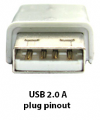
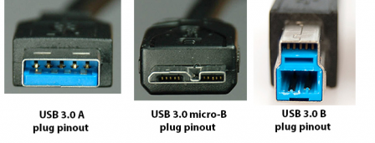
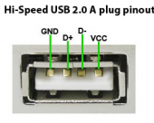
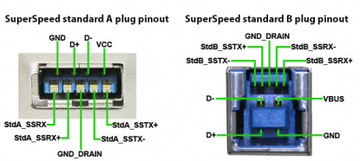
USB Connectors and Pin-out – USB 2.0 VS 3.0
USB 2.0
USB 3.0

Slide 6
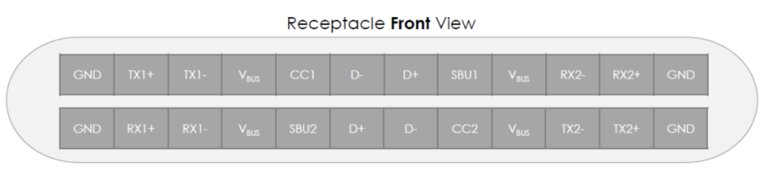

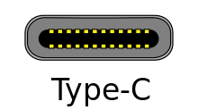
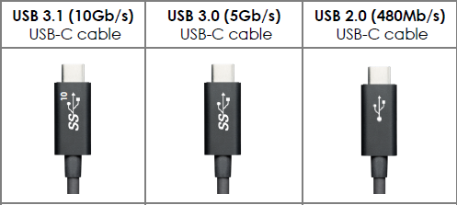
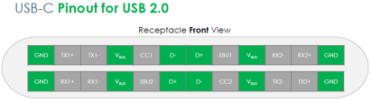
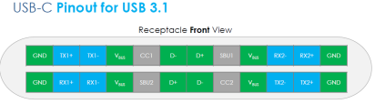
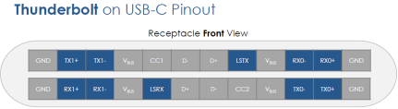
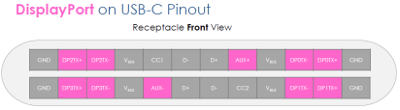
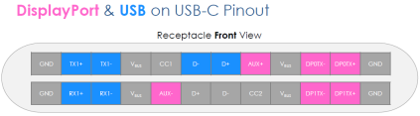
USB Connectors and Pin-out - USB-C

Slide 7
USB 3.0 Performance
Max. Throughput MB/S
2750MB/s
Multi-Media | MP3 | JPEG | DVD | Blu-Ray DVD
Avg. Volume | 5MB | 10MB | 8GB | 50GB
Transmission By USB2.0 | 0.16 Sec. | 0.33 Sec. | 4Min 26.66Sec. | 27Min 46.66 Sec.
Transmission By USB3.0 | 0.01 Sec. | 0.03 Sec. | 26.66Sec. | 2Min 46.66 Sec.
1375MB/s
800MB/s
400MB/s

Slide 8
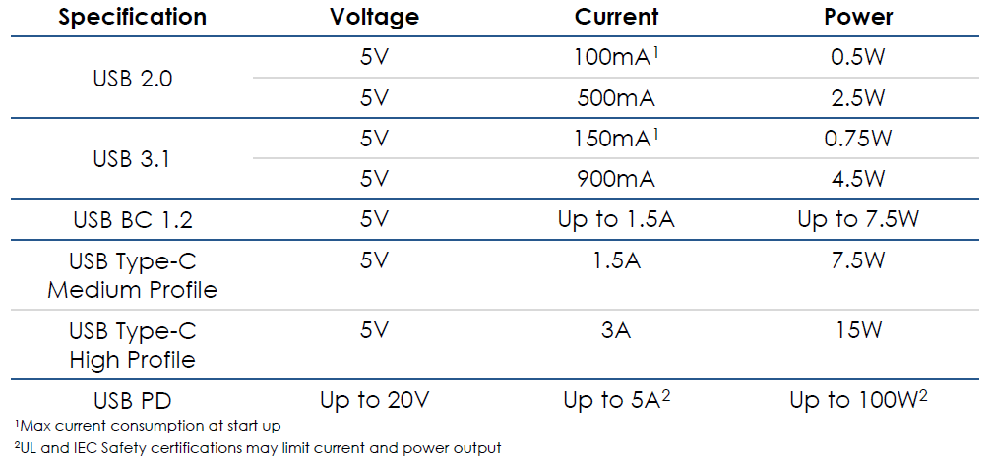
USB Power

Slide 9
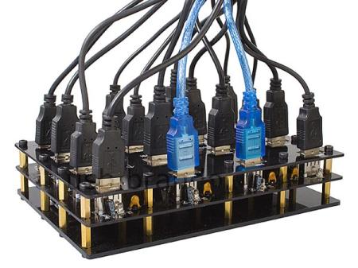
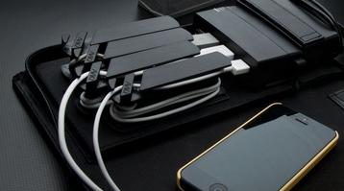
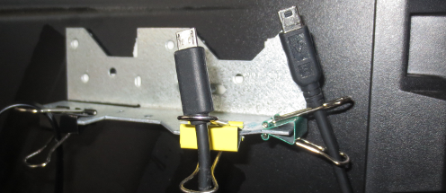
Why do I need a USB Sharing Switch?
More and More peripheral devices are using the USB 3.0 interface for High-bandwidth requirements and faster speeds.
Solves cable management problems, saves work space, and you can switch between a laptop and PC with single click.
Easy to install with plug-and-play convenience. No additional drivers required.

Slide 10
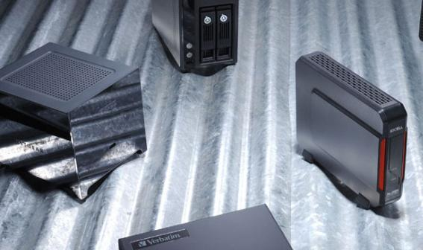
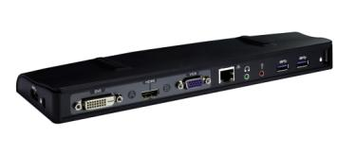
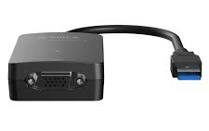
Product Features, Advantages and Benefits
A SOHO/SMB sharing switch offers more versatile & centralized access to data and information
2/4 port connections adds usability and possibilities
Share four USB 3.0 devices between computers with a single click and super-speed
Highly compatible with most USB 3.0/2.0/1.1 peripherals – such as docks, cameras and video adapters without performance loss
Stylish design with LED indicators showing which computer has access
Optional 5V micro USB connector provides extra power supply up to 1A for high power consumption of 2/4 peripheral devices

Slide 11
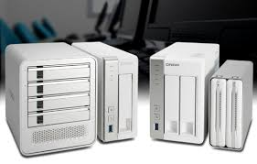
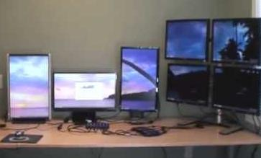
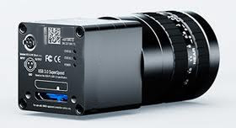
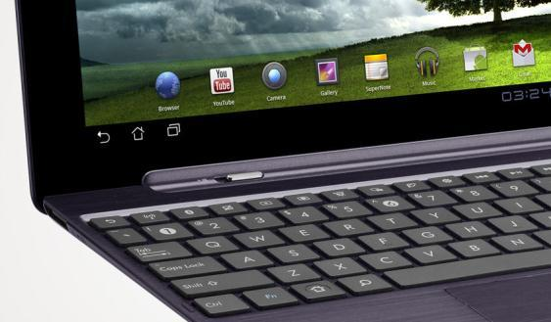
Ideal Solutions:
Data Storage Management
Video Expansion
Hi-Res Industrial/Medical
Digital Imaging Expansions
SOHO Computer Access & Peripheral Expansion

Slide 12
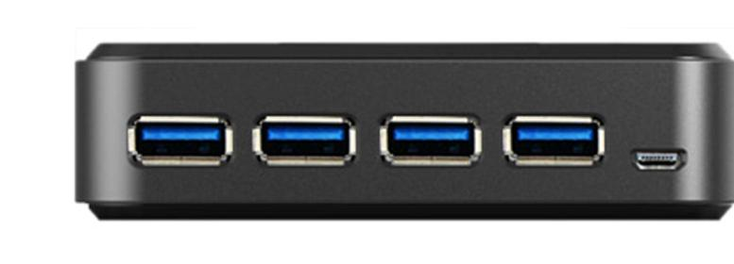
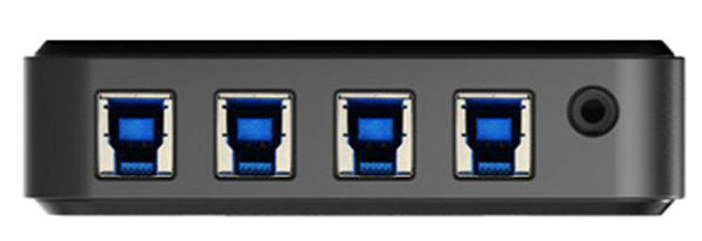
US234/US434 Front/Rear View
Front
1
2
US434
Rear
3
4
1. Peripheral Ports(DFP): 4-port USB 3.0 hub
2. Micro USB Port: 5V power for USB devices
3. Computer Ports(UFP):
2 x USB 3.0 console ports (US234)
4 x USB 3.0 console ports (US434)
4. Remote Selector Port: Pushbutton switch

Slide 13

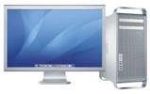
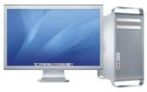

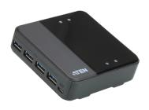



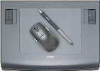



Product Application 1
2/4 Computer Ports
Remote Selector
USB3.0
USB2.0
4 USB Peripheral Ports
USB 2.0
Legacy Device
USB Capture
Device
SSD/Storage
USB Graphics/Docking Station

Slide 14
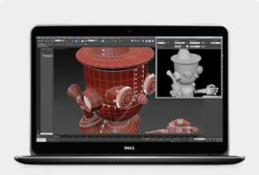
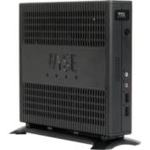
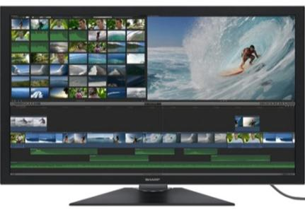
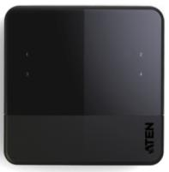
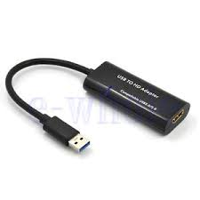
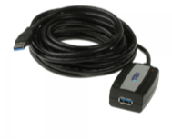
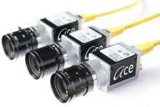
Product Application 2
USB3.0
Video
Mobile Workstation
Workstation
Access
USB 3.0
US234/US434
HDMI/DP/DVI/VGA Display
UE350A
15ft Extender
USB 3.0 to Video Adapter
USB 3.0 Graphic Device

Slide 15
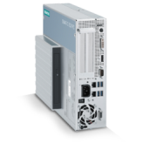

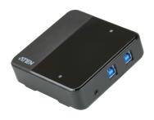


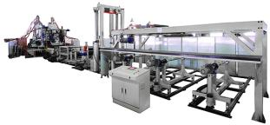
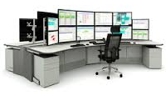
Product Application 3
Industrial PC
2/4 Computer Ports
RS232
Production
Equipment
USB 3.0
4 USB
Peripheral Ports
UC232A
Programmed MCU

Slide 16
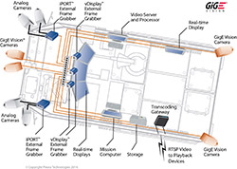
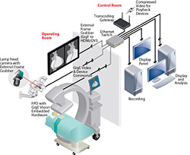

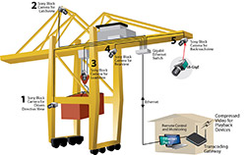
Product Application 4
Military
Medical
Automation
Automotive & GIS
Visual Inspections & Fiducial Alignments
  Most systems today rely on Camera Link for bandwidth and reliability
  Next-Gen USB can reduce system costs significantly
  High flex cables are critical in this application

Slide 17
Value Analysis
US234 priced $69.99
US434 priced $94.99
MSRP
$99
Connector for Extra Power
Reliability
1.2 m/1.8 m USB3.0 Cable
Remote Switch
Connector for Extra Power
Convenience
1.2 m USB 3.0 Cable
4 Peripheral Ports
$60
Remote Switch
Convenience
4 Peripheral Ports
4 Computer Ports
Productivity
$30
2 Computer Ports
2-to-1 ports
Flexibility
2-to-1 ports
Baseline

Slide 18





Product Comparison
Brand | ATEN | ATEN | PXXXXXle | SXXXXXch | TXXXXXXXXXc | SXXG | SXXa
Model Name | US234 | US434 | USB3-SWITCH2 | USB221SS | TUS-300 | JU-SW0012-S1 | SY-SWI20164
Image
USB DFP (Host) | x2 | x4 | x 2 | x 2 | x 2 | x 2 | X2
Interface | USB 3.0 up to 5Gbps | USB 3.0 up to 5Gbps | USB 3.0 up to 5Gbps | USB 3.0 up to 5Gbps | USB 3.0 up to 5Gbps | USB 3.0 up to 5Gbps | USB 3.0 up to 5Gbps
USB UFP (Device) | x4 | x4 | x1 | x1 | x1 | x1 | x1
Extended Push Button | Y | Y | N | N | N | N | N
Case Material | Plastic | Plastic | Plastic | Plastic | Plastic | Plastic | Plastic
USB Cable included | Yes | Yes | Yes | Yes | Yes | Yes | Yes
Power Adapter Required | NA | NA | NA | NA | NA | NA | NA
Extra Power Supply Connector* | YES | YES | NA | NA | NA | NA | NA
MSRP | USD69.99 | USD94.99 | USD24.95 (Amazon) | USD32.1 (Amazon) | USD24.99 (Amazon) | USD30.99 (Amazon) | USD19.99 (Amazon)
* In case some devices consume electricity much higher than what spec defines

Slide 19
Package Contents
1 US234/US434 Peripheral Sharing Device
2 1.2 m USB 3.0 Cable
2 1.8 m USB 3.0 Cable (US434 Only)
1 Remote Button Switch
1 Quick Start Guide
N. W/G.W:
  US234/US434 : 0.27/0.43 kg , 10 pcs per carton
  US434: 0.46/0.61 kg , 10 pcs per carton
Dimensions:
  US234/US434: 9.37x 9.37 x 2.68 cm

Slide 20
Ordering Information
EAN / UPC code
Model Name: US234-AT
UPC: 6-72792-00682-1
EAN: 4719264643781
Model Name: US434-AT
UPC: 6-72792-00683-8
EAN: 4719264643798

Slide 21
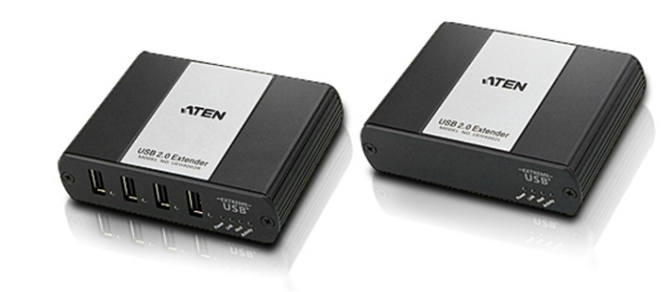
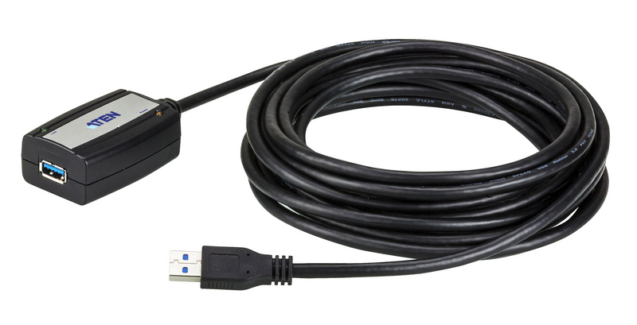
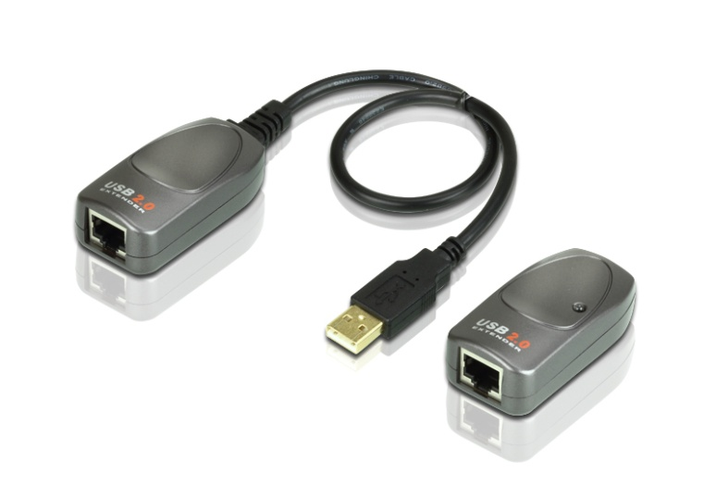
Items to Consider
Bring these items when approaching customers:
  UE350A 5 meter USB 3.0 Extender
  UCE260 60 meter USB 2.0 Extender
  UEH4002 100 meter USB 2.0 Extender

Slide 22
FAQ

Slide 23
FAQ (I)
Are there problems when the US234/US434 switches hard drives, flash drives, or other storage devices?
A: When the remote switch is pressed, the effect is essentially the same as if you were to unplug the storage device from one system and then plug it into another. There are two ways to reduce the risk of data loss:
1: “Eject” the storage device from the Operating System prior to switching USB access between computers.
  Windows: Click the Safely Remove Hardware icon in the taskbar/notification area, and then stop/eject the USB storage device.
  Mac: Open Finder. Under the Devices category on the left, click the eject icon next to the USB storage device.
  Linux: Unmount the device by ejecting it through the graphical environment, or use the unmount command.
2: (Windows Only) Enable the “Quick Removal” setting for the storage device within the Windows operating system (Windows 7 and later). The OS will often implement this setting by default on devices that it detects as portable.

Slide 24
FAQ (II)
Can I use USB 3.0 cables longer than the cables that are included with US234/US434?
Yes, but USB 3.0 transfers are very sensitive to attenuation and interference, and these problems can become more pronounced in situations where longer cables are used. Make sure you are not exceeding the cable length limit of 3 meters. We suggest using an appropriate USB 3.0 extender (ATEN UE350A) for distances over 3 meters.

Slide 25
FAQ (III)
When should I use the micro USB cable connection for power?
When all USB ports are connected to peripherals or when connecting high power consumption devices such as storage devices. We suggest connecting the micro USB cable to supply additional power for advanced USB device operations.

Slide 26
FAQ (IV)
Is there any port selection hotkey for US234/US434?
No, there is no hotkey function on the US234/US434. You must use the remote selector pushbutton to switch devices. There is no internal CPU to process hotkey commands.

Slide 27
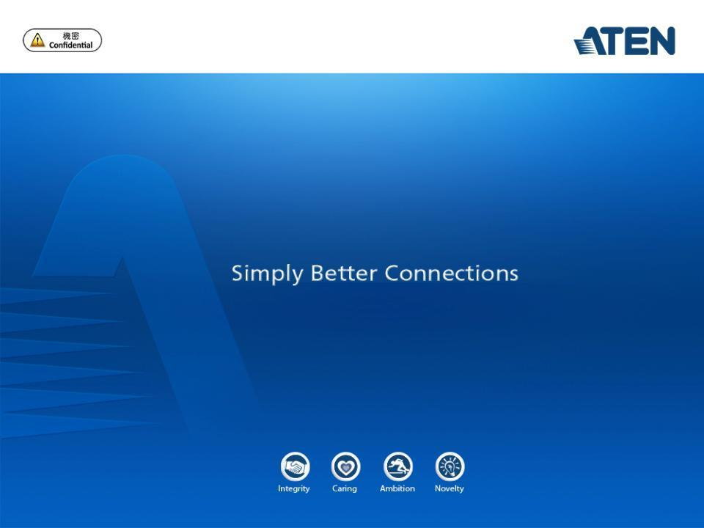
本文件未經許可不得任意轉載、披露。
This file contains information that is for sole use of the intended recipient and may be confidential or privileged. ANY UNAUTHORIZED REVIEW, COPYING, DISCLOSURE, USE OR DISTRIBUTION IS STRICTLY PROHIBITED.

