Slide 1

UE3310/UE3315 Product Guide
10m/15m USB3.1 Gen1 Extender Cable
Product Manager: Ethan Yu
SOHO Solution Dept.
本文件未經許可不得任意轉載、披露。
This file contains information that is for sole use of the intended recipient and may be confidential or privileged. ANY UNAUTHORIZED REVIEW, COPYING, DISCLOSURE, USE OR DISTRIBUTION IS STRICTLY PROHIBITED.

Slide 2
Outline
What is the UE3310/UE3315
USB Overview
Product Feature, Advantage and Benefit
Product Applications & Comparison
Package Content & Order Information

Slide 3
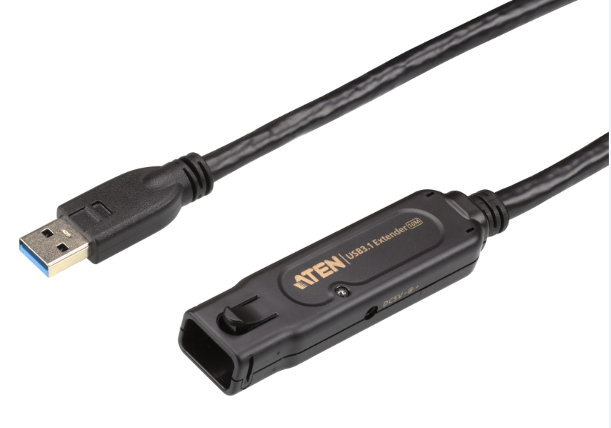
What is UE3310
Product name:UE3310
Product description: 10M USB3.1 Gen1 Extender Cable
MSRP: USD99/EURO99
Specification
  Active Repeater cable length up to 10 meters
  Support daisy-chain connection up to 50m with unique cable locking mechanism
  USB 3.1 / 2.0 / 1.1 compliant
  Supports USB 3.1 super speed up to 5.0Gbps
  USB bus power/DC self-power
  Over current detection and protection
  Driver Free, Plug & Play without configuration
  5V/1.5A power adapter and extension cable included
  Compatible with PC & Mac

Slide 4
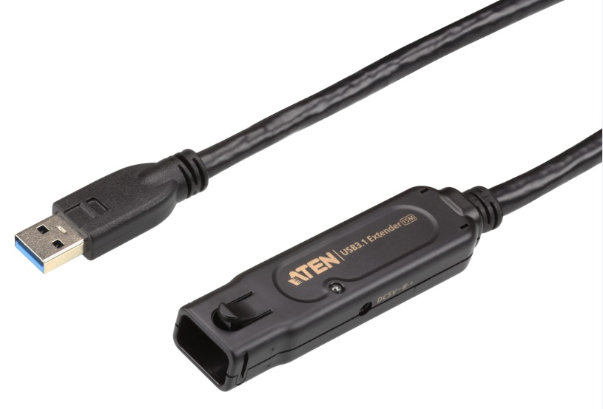
What is UE3315
Product name:UE3315
Product description: 15M USB3.1 Gen1 Extender Cable
MSRP: USD159/EURO159
Specification
  Active Repeater cable length up to 15 meters
  Support daisy-chain connection up to 50m with unique cable locking mechanism
  USB 3.1 / 2.0 / 1.1 compliant
  Supports USB 3.1 super speed up to 5.0Gbps
  USB bus power/DC self-power
  Tiny signals booster block designs
  Over current detection and protection
  Driver Free, Plug & Play without configuration
  5V/1.5A power adapter and extension cable included
  Compatible with PC & Mac

Slide 5
Product Features, Advantages and Benefits
Upgrade USB data channel to SuperSpeed USB 3.1 Gen1 spec with future-proofed, stable 5 Gbps data transfer rate and also maintain backward compatibility with existing USB 2.0 peripherals
The integrated signals booster ensure the USB performance at longer lengths (over 3m limitation) than a normal USB extension cable
Tool-less, unique cable locking mechanism improve smoothly daisy-chain installation on the field-side cable deployment.
Power adapter package included, provide sufficient power supply, superior cable performance and error-free data transmission for downstream devices.
Plug-and-play convenience. No additional drivers required.
UH3231
Micro Dock

Slide 6
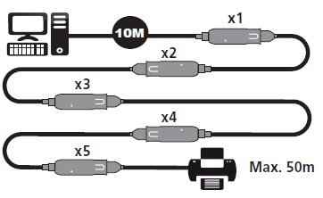
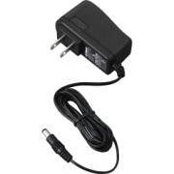
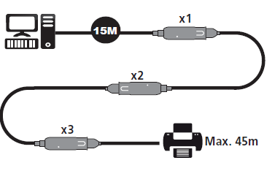
Connection Diagram – UE3310 / UE3315
UE3310 x5pcs
UE3315 x3pcs

Slide 7
UE3310/UE3315 Front/Rear View
2
4
1
3
USB 3.1 Gen1 Type-A Male with cable locking
USB 3.1 Gen1 Type-A Female
DC 5V power input
Power Status LED

Slide 8
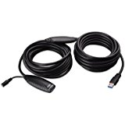
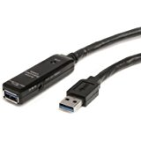
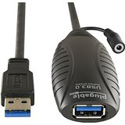
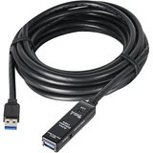
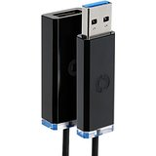
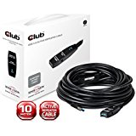
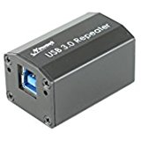
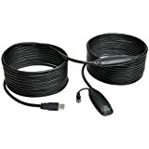
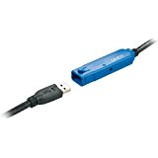
Product Comparison - UE3310
Brand | ATEN | Cable Matters | Plugable | SIIG | StarTech | TrippLite | Corning | Club3D | Newnex | LINDY
Model Name | UE3310 | SuperSpeed USB 3.0 Type A Male to Female Active Extension Cable 10 Meters/32.8 Feet | 10 Meter (32 Foot) USB 3.0 Active Extension Cable with AC Power Adapter Included | JU-CB0611-S1 | USB3AAEXT10M | U330-10M | Optical Cables by Corning USB 3.0 Optical Cable 10 Meter | CAC-1402 | FireNEX-uLINK Dongle Repeater | 10 Meter USB 3.0 Active Extension Cable Pro (43157)
Distance | 10m | 10m | 10m | 10m | 10m | 10m | 10m | 10m | 10m | 10m
Daisy chained | V, up to 50m | X | X | X | V,up to 20m | X | X | X | X | V, up to 50m
Lock/screw | V | X | X | X | X | X | X | X | V | V
Type | Cable | Cable | Cable | Cable | Cable | Cable | Cable | Cable | Repeater | Cable
Additional USB power input | X | X | X | X | X | X | X | X | X | X
Booster block | X | V | V | X | X | V | X | V | X | X
Power Adapter Required | V | X | V | V | V | V | V | V | X | V
MSRP (USD) | 99 | 62.99 | 62.99 | 99.99 | 107.99 | 187.59 | 137.9 | 71.6 | 78.99 | 155

Slide 9
Product Comparison – UE3315
Brand | ATEN | SIIG | KYOCERA-STRATEGIC | TrippLite | Corning | Club3D
Model Name | UE3315 | JU-CB0711-S1 | USB 3.0 ACTIVE REPEATER CABLE-15M | U330-15M | Optical Cables by Corning USB 3.0 Optical Cable 10 Meter | CAC-1403
Distance | 15m | 15m | 15m | 15m | 15m | 15m
Daisy chained | V, up to 50m | X | X | X | X | X
Lock/screw | V | X | X | X | X | X
Type | Cable | Cable | Cable | Cable | Cable | Cable
Additional USB power input | X | X | X | X | X | X
Booster block | V | V | V | V | X | V
Power Adapter Required | V | V | V | V | V | V
MSRP (USD) | 159 | 149.99 | 165.35 | 193.11 | 164.99 | 99.9

Slide 10
Package Contents
1 UE3310 10m USB3.1 Gen1 Extender Cable
1 USB Extension Cable
1 Power Adapter
N. W.
    UE3310: 0.763kg , 5 pcs per carton
Dimensions(WxDx H): UE3310: 8.2x2.2x1.3cm
1 UE3315 15m USB3.1 Gen1 Extender Cable
1 USB Extension Cable
1 AC power Adapter
N. W.
    UE3315 : 1.165kg , 5 pcs per carton
Dimensions(WxDx H): UE3315: 8.2x2.2x1.3cm

Slide 11
Ordering Information
EAN / UPC code
Model Name: UE3310-AT-A
UPC : 6-72792-00727-9
EAN : 4719264645365
Model Name: UE3315-AT-A
UPC : 6-72792-00728-6
EAN : 4719264645372

Slide 12
FAQ

Slide 13
FAQ (I)
What is maximum distance support of UE3310/UE3315 under daisy-chain combination?
The maximum distance supported by UE3310 / UE3315 is 50m under daisy-chain combination. User can freely mix-connect UE3310 and UE3315 units together to meet distance requirement under 50m limitation.

Slide 14
FAQ (II)
When should I connect AC power adapter with UE3310/UE3315?
The external power adapter (5V/1.5A) is required when connected to a high power device or the last repeater cable in daisy-chain connection.

Slide 15
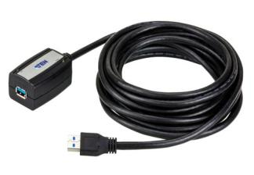
More Items to Consider
Carry those items when you approach customer:
    US234/US434 2/4-port USB3.1 Gen1 Sharing Device
    UE350A 5m USB 3.1 Gen1 Extender Cable

Slide 16
USB 3.1 Gen1 Performance
Max. Throughput MB/S
2750MB/s
Multi-Media | MP3 | JPEG | DVD | Blu-Ray DVD
Avg. Volume | 5MB | 10MB | 8GB | 50GB
Transmission By USB2.0 | 0.16 Sec. | 0.33 Sec. | 4Min 26.66Sec. | 27Min 46.66 Sec.
Transmission By USB3.0/3.1Gen1 | 0.01 Sec. | 0.03 Sec. | 26.66Sec. | 2Min 46.66 Sec.
1375MB/s
800MB/s
400MB/s

