Slide 1

US7220 Product Guide Thunderbolt 2 Sharing Switch
Product Manager: Ethan Yu
SOHO Solution Dept.
本文件未經許可不得任意轉載、披露。
This file contains information that is for sole use of the intended recipient and may be confidential or privileged. ANY UNAUTHORIZED REVIEW, COPYING, DISCLOSURE, USE OR DISTRIBUTION IS STRICTLY PROHIBITED.

Slide 2
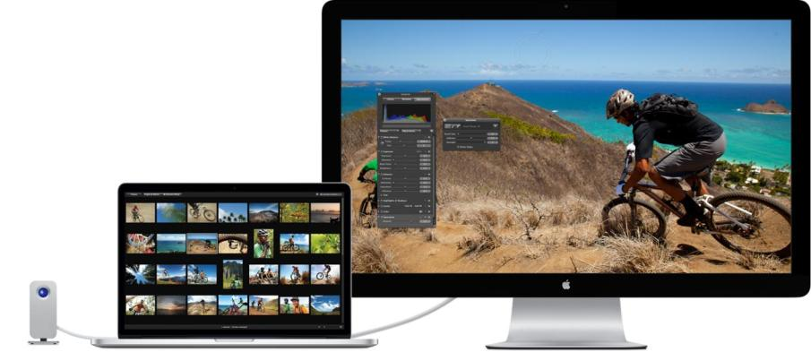

Background

Slide 3
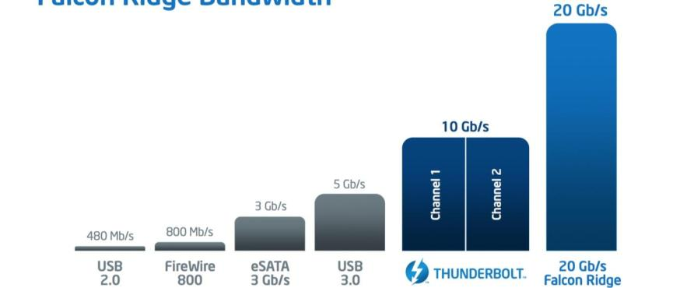
What is Thunderbolt 2
Thunderbolt 2 is an update to the original Thunderbolt specification and takes the original’s two 10 Gbps bi-directional channels and combines them into a single 20 Gbps bi-directional channel. The amount of data able to go through a Thunderbolt connection hasn’t increased, but the throughput of a single channel has been doubled.

Slide 4
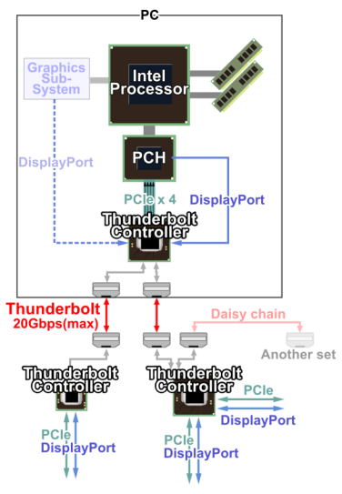

What is Thunderbolt 2
Thunderbolt combines PCI Express and DisplayPort into a single connection, allowing for a combination of up to six peripherals, like storage devices and monitors, to be daisy-chained together.

Slide 5
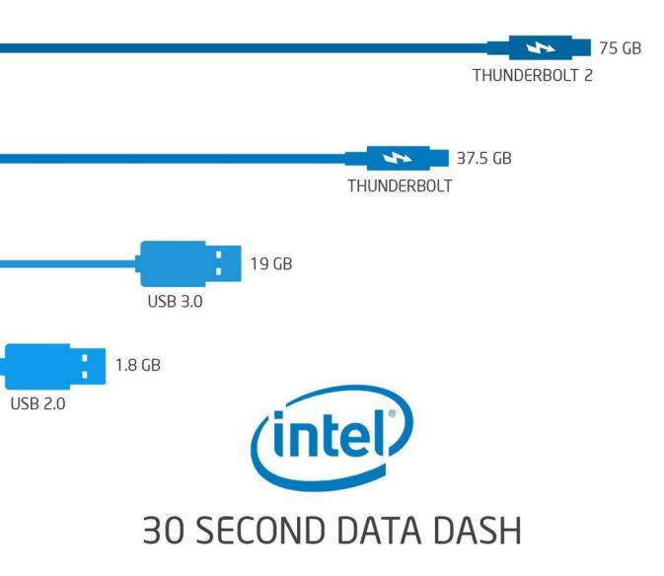
High Data Bandwidth

Slide 6
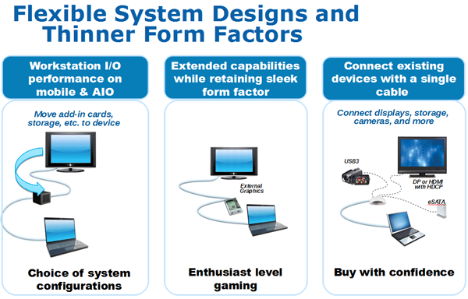
Benefit of Thunderbolt Technology

Slide 7
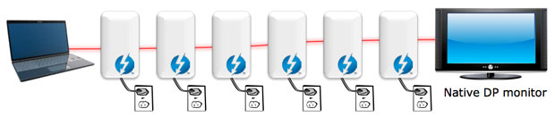
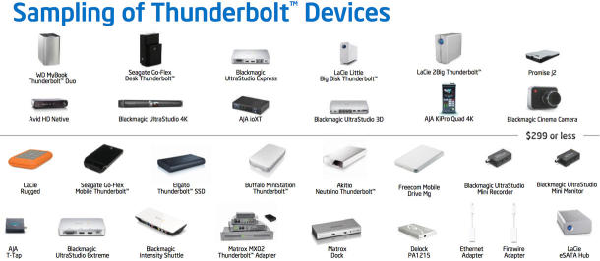
Connectivity
Up to Six Devices Daisy-chained in Single Cable

Slide 8
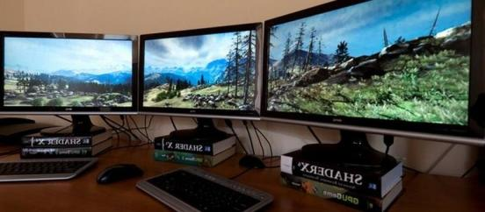
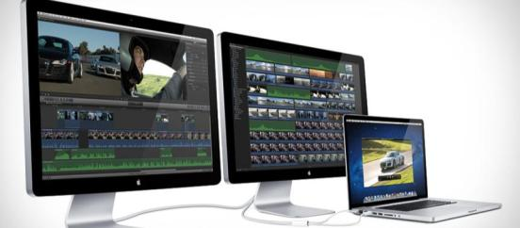
Comparison of Workstation Enviroment
PC
Traditional Cabling
Thunderbolt Cabling
Mac

Slide 9
Thunderbolt Computer Update
100 million
Computers with Thunderbolt / Thunderbolt 2 by the end of 2015

Slide 10

Thunderbolt Computer Update
250+
Certified Thunderbolt peripheral devices

Slide 11
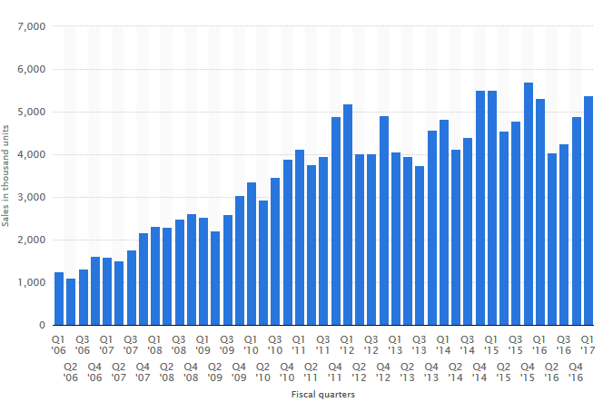
Mac with Thunderbolt Port
Thunderbolt
Ready
1.0
2.0

Slide 12
What is US7220?
Product name:US7220
Product description: Thunderbolt 2 Sharing Switch
MSRP: USD599/EURO599
Specification
2-port Thunderbolt 2 (TBT2) switch of Thunderbolt peripherals
Up to 20 Gbps data throughput via Thunderbolt 2.0 technology
Support Dual-view display by Thunderbolt + HDMI monitors
Suitable for desktop control and peripheral sharing of multiple Thunderbolt Host environment
Support DisplayPort v1.2, max. resolution up to 3840x2160@60Hz (UHD)via Thunderbolt port
Support HDMI v1.4b, max. resolution up to 3840x2160@30Hz
Integrated 3-port USB 3.1 Gen1 Hub, e-SATA, GbE hub, 2-port USB2.0 Hub, digital audio line-in/out
1x TBT2 cable, vertical stand and solid-rock, high efficiency power adapter included
Compatible with TBT3 Host via TBT Legacy adapter
Compatible with PC & Mac

Slide 13
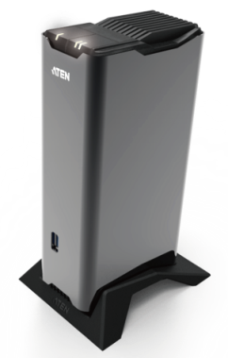
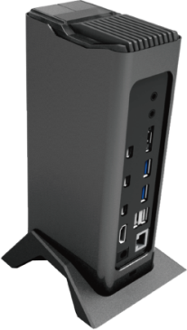
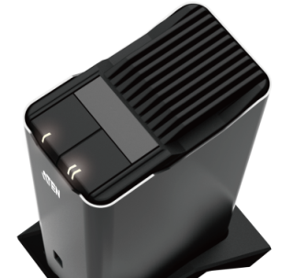
Designs

Slide 14
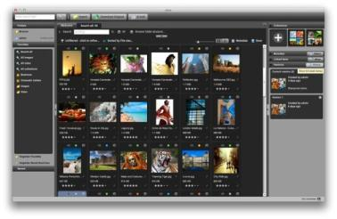
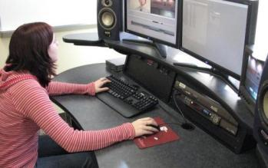
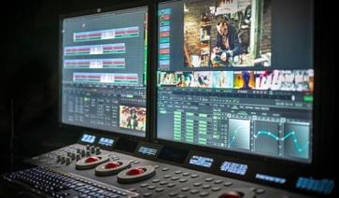
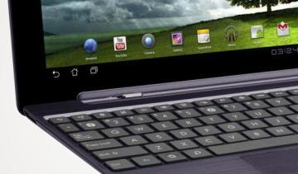
Ideal Solutions:
Media Management
Multi Displays workplace
Video Editing
A/V post production
A/V Post Production
Connectivity Expansion for productivity enhancement

Slide 15
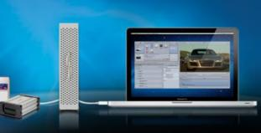
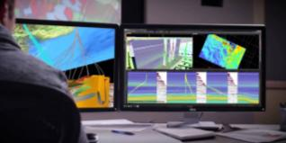


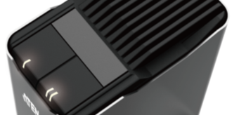
Why US7220?
Support Thunderbolt 2.0 protocol and backward compatible with pervious Thunderbolt devices
Support traditional and Thunderbolt displays to computer at ultra-high resolution simultaneously
Support multiple connectivity options up to 11 devices for external displays and legacy peripherals
2-port switch with LED indicator designs for single-tapping, smooth device switching

Slide 16
US7220 Provide…
WW first single-tapping for 2-port TBT host switching device
Single cable installation for video, data and essential interfaces expansion
Vivid and stunned dual-view 4K UHD image quality display via HDMI monitor and Thunderbolt monitor
Blazingly fast Thunderbolt technology provide daisy-chained capability up to 5 additional Thunderbolt devices
3-port USB3.1 Gen1 port, eSATA and GbE LAN Port for ultra-speed and robust outbound connection
Digital audio line-in & line-out for professional A/V editing environment

Slide 17

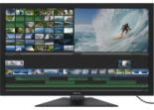




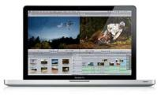


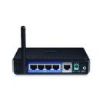
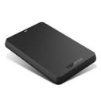
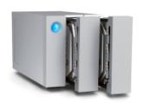
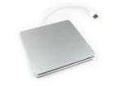

Connection Diagram
1
2
3
Thunderbolt Device x4
Thunderbolt Display
4K HDMI/DP Display
Thunderbolt Display
1
Mac 1 with Thunderbolt Connection
Mac 2 with Thunderbolt Connection
US7220
GbE
Digital Line in/Out
eSATA
USB2.0/USB3.1 Gen1
Thunderbolt
DP/HDMI
Gigabit Ethernet
Digital Recorder
USB3.1 Gen1 Devices
PELS

Slide 18
Multi-Displays Scenario w/ TBT Switch or Dock
TBT port Requirement |  | TBT Dock | TBT Switch | TBT Monitor | DP Monitor | TBT Monitor2 | Display-mode
Macbook Air 2015 | 1 |  |  |  | 1 |  | Dual-Displays (w/ built-in display)
 | 1 |  |  | 1
 | 1 | 1 |  | 1 | 1 |  | Multi-Displays
 | 1 (Host A) +1(Host B) |  | 1 | 1 | 1
Mac mini 2015 /Mac Pro/ Macbook Pro 2013 | 2 |  |  | 1 |  | 1
 | 2 | 1 |  | 1 | 1 | 1
 | 2 (Host A) +2(Host B) |  | 1 | 1 | 1 | 1

Slide 19
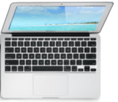


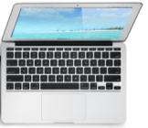
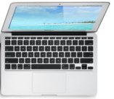
Connection Diagram- Thunderbolt Sharing Switch
PC1
US7220
Thunderbolt Device x5
PC2
Case A
Thunderbolt Device x5
Case B
PC
US7220
Thunderbolt Device x5

Slide 20
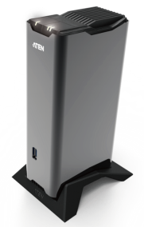
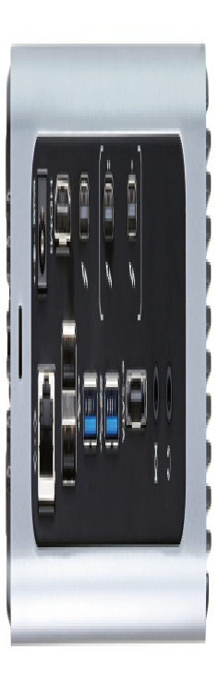
US7220 Front/Rear View
6
5
3
4
7
Rear
1
2
8
3
1. Thunderbolt port x3
2. HDMI port x1
3. USB 3.1 Gen1 port x 3
4. USB 2.0 port x 2
5. eSATA x 1
6. Digital audio line-in/out (Mini TOSLINK)
7. GbE LAN port
8. DC barrel jack
Front

Slide 21
US7220 Package Content
1 US7220 Thunderbolt 2 Sharing Switch
1 1m Thunderbolt Cable
1 12V 90W Power Adapter w/ Power Code
1 Vertical Stand
1 Quick Start Guide
N. W.:
US7220 : 0.77kg , 3pcs per carton
Dimensions(WxDx H): US7220: 57 x 98 x 184 mm

Slide 22
Ordering Information
EAN / UPC code Model Name: US7220-AT-A UPC : 6-72792-00726-2 EAN : 4719264645235

Slide 23
FAQ

Slide 24
FAQ (I)
What Kinds of Computer Support US7220?
Computers with Thunderbolt* connection
The following Mac models are Thunderbolt 2 capable:
MacBook Pro (Retina, Late 2013 and later)
Mac Pro (Late 2013)
iMac (Retina 5K, 27-inch, Late 2014)
Mac mini (Late 2014)
*Thunderbolt 2 systems can take advantage of the 20Gbps transfer speed.
*Thunderbolt 3 systems with extra legacy adapter can take advantage of the 20Gbps transfer speed.

Slide 25
FAQ (II)
Does Original Thunderbolt Devices Work with US7220?
Yes. US7220 uses the same connectors as the original Thunderbolt, so it will be backwards compatible with Thunderbolt peripherals and vice versa. But a Thunderbolt device connected to a US7220 will perform at the Thunderbolt speed of 10 Gbps.
If you have a mix of generations on a Thunderbolt 2 daisy chain, make sure that the Thunderbolt devices sit after the Thunderbolt 2 devices on the chain. Otherwise those Thunderbolt 2 devices will operate at Thunderbolt speeds.

Slide 26
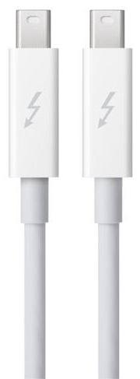
FAQ (III)
Can I Connect Mini DisplayPort Displays to US7220 Docking Station?
Yes , US7220 does work with MiniDisplayPort (mDP)/DisplayPort (DP) displays but no the daisy-chaining capabilities.

Slide 27
FAQ (IV)
Can US7220 Support Two HDMI Monitor via Additional HDMI Adapter?
To support dual-view display mode on US7220, at least one monitor has to be Thunderbolt or Thunderbolt 2 technology-ready. For monitors that are not Thunderbolt technology-ready, the Thunderbolt port is backwards compatible with Mini DisplayPort. The US7220 supports either HDMI or Mini DisplayPort, but not both.
Video Resolution | Single View | Mini DisplayPort / Thunderbolt* | 3840*2160@60
 |  | HDMI | 3840*2160@30
 | Dual View | Thunderbolt | 3840*2160@60
 |  | HDMI | 3840*2160@30

Slide 28
FAQ (V)
How do I connect my Mini DisplayPort Monitor or Monitor Using a Mini DisplayPort Adapter to My Thunderbolt-Equipped Mac When I Have Other Thunderbolt Devices Connected?
When connecting a Mini DisplayPort display or a display using a Mini DisplayPort adapter to a Thunderbolt peripheral, make sure the display is connected at the end of the Thunderbolt chain. You can use only one Mini DisplayPort device in the Thunderbolt chain.
Systems with more than one Thunderbolt port, like an iMac, can have more than one Mini DisplayPort monitor or monitor connected with a Mini DisplayPort adapter connected as each Thunderbolt port can support one Mini DisplayPort display.

Slide 29
FAQ (VI)
Can I Connect a Mini DisplayPort display to Thunderbolt Display for Computers that Support Using More Than One Display?
Mini DisplayPort displays will not function if connected to the Thunderbolt port of an Thunderbolt Display. Displays connected via Mini DisplayPort video adapter or cable to the Thunderbolt port of an Thunderbolt Display will not work.

Slide 30
FAQ (VII)
How Many Thunderbolt Displays can I use with Mac in OS X?
Each Thunderbolt chain on the Mac can support maximum one Thunderbolt display and one Mini DisplayPort display

Slide 31
FAQ (VIII)
Can I connect a Mini DisplayPort display to Apple Thunderbolt Display for computers that support using more than one display?
Mini DisplayPort displays will not function if connected to the Thunderbolt port of an Apple Thunderbolt Display. Displays connected via Mini DisplayPort video adapter or cable to the Thunderbolt port of an Apple Thunderbolt Display will not work.

Slide 32
FAQ (IX)
Can I mix Thunderbolt and Thunderbolt 2 cables and devices?
Yes. All Thunderbolt cables work with Thunderbolt 2 / Thunderbolt ports and devices.

Slide 33
FAQ (X)
Can US7220 Support Microphone or Head-Phone?
Digital audio line-in/line-out ports support both optical or analog sound devices

Slide 34
FAQ (XI)
Can US7220 Support USB emulation? Will US7220 disconnect the downstream devices after port-switching?
US7200 do not support any protocol emulation, all the downstream devices connected with US7220 will be disconnect after port-switching.

Slide 35
Appendix

Slide 36
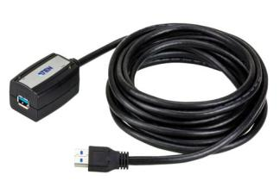
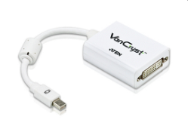
More Items to Consider
Carry those items when you approach customer:
UEH4002 100m USB2. 0 Extender
UCE260 60m USB2.0 Extender
UE350A 5m USB 3.1 Gen1 Extender Cable
UE3310 10m USB 3.1 Gen1 Extender Cable
UE3315 15m USB 3.1 Gen1 Extender Cable
VC960 Mini DisplayPort to Single-Link DVI adapter

Slide 37
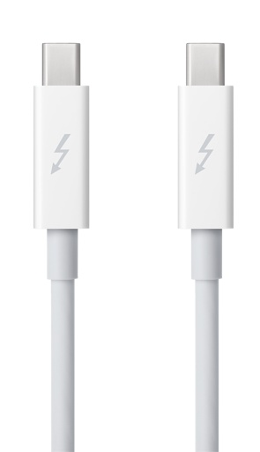
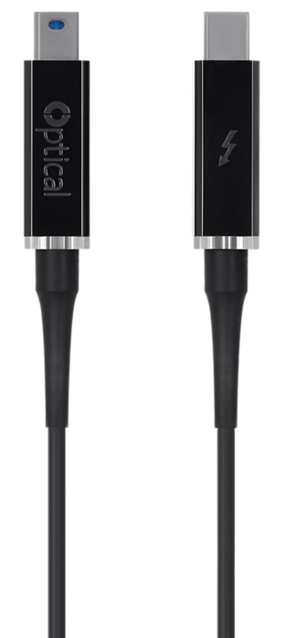
Max. Cable Length Support by Thunderbolt 2
Copper Cable – up to 2m
0.5m/1m/2m (Sold separately )
Optical Cable – up to 60m
5.5/10/30/60m (Sold separately )

Slide 38
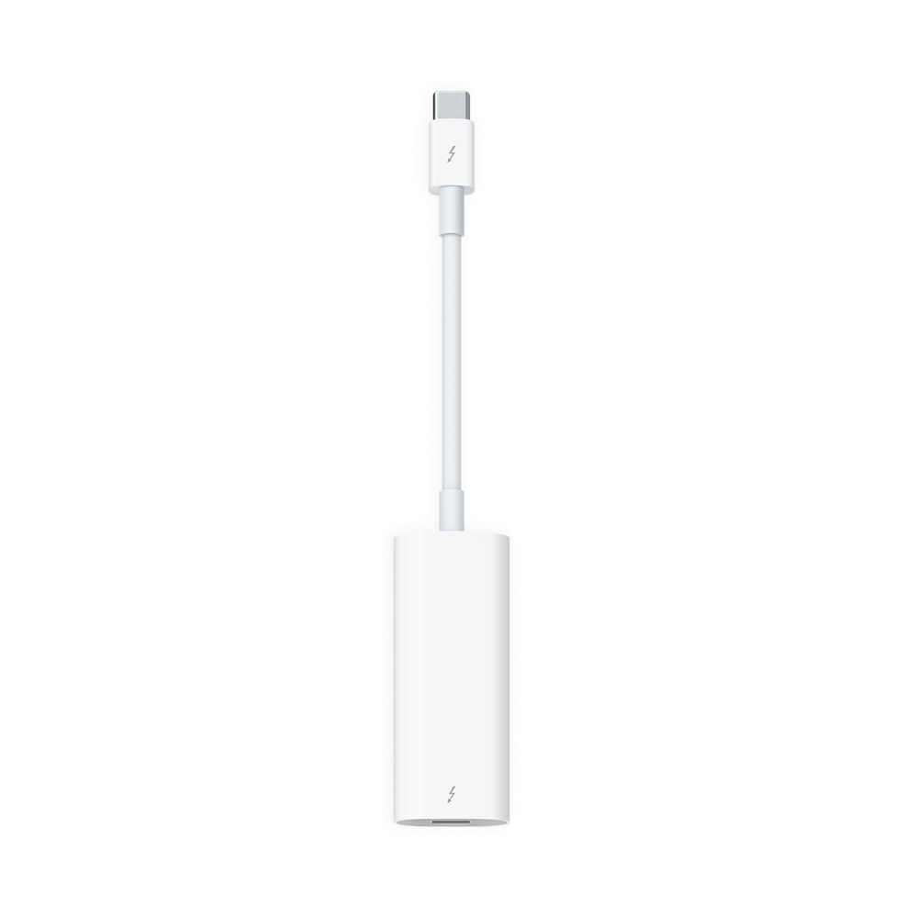
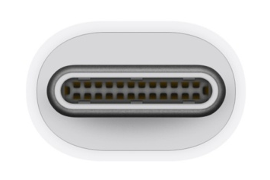

Compatibility with Thunderbolt 3 Host
Apple Thunderbolt 3 (USB-C) to Thunderbolt 2 Adapter (legacy adapter) required for US7220
Legacy adapter supports Thunderbolt devices only Will not support native DisplayPort displays
It can also connect new Thunderbolt 3 devices to a Mac with a Thunderbolt or Thunderbolt 2 port and macOS Sierra.
(Sold separately on Apple store ) http://www.apple.com/shop/product/MMEL2AM/A/thunderbolt-3-usb-c-to-thunderbolt-2-adapter?fnode=8b

Slide 39
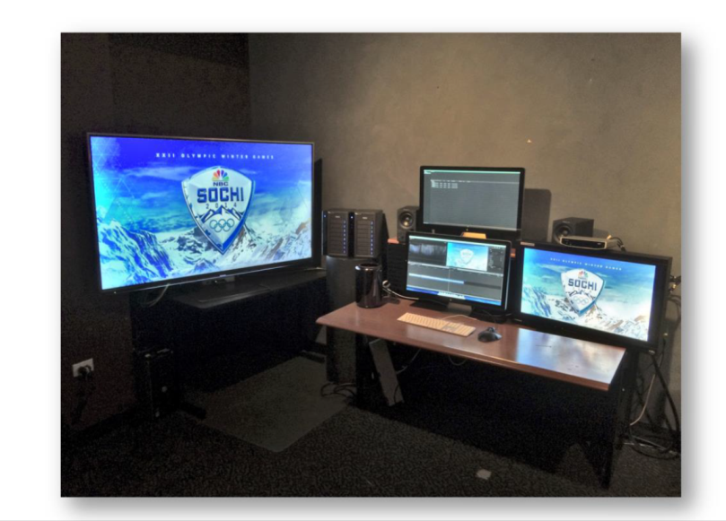
Thunderbolt 2 UHD/4K Video Editing by NBC TV

Slide 40

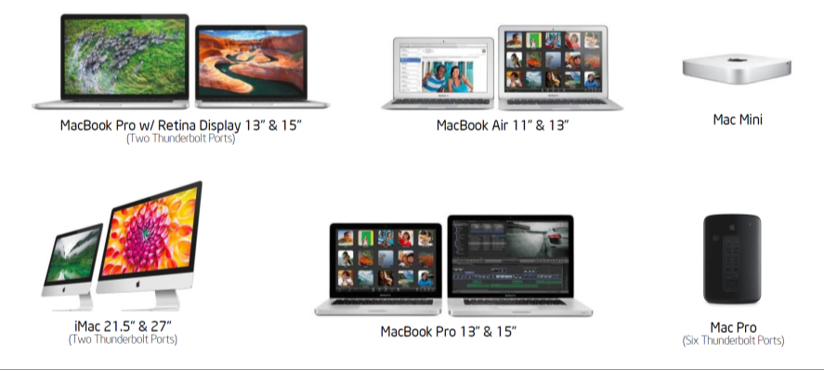
Macs with Thunderbolt 2

Slide 41






Product Comparison
Brand | IOGEAR | Elgato | Belkin | StarTech.com | StarTech.com | Caldigit | Akitio
Model Name | GTD720 | Elgato Thunderbolt™ 2 Dock | Thunderbolt™ 2 Express Dock HD with Cable | Thunderbolt Laptop Docking Station | Thunderbolt 2 Laptop Docking Station | Thunderbolt Station | AKiTiO Thunder2 Dock (Coming Soonn)
Image
HDMI Port | O x 1 | O x 1 | O x 1 | O x 1 | O x 1 | O x 1 | NA
Data transfer | Thunderbolt up to 20Gbps | Thunderbolt up to 20Gbps | Thunderbolt up to 20Gbps | Thunderbolt up to 10Gbps | Thunderbolt up to 20Gbps | Thunderbolt up to 10Gbps | Thunderbolt up to 20Gbps
USB Port | O 3.0 x 3 | O 3.0 x 3 | O 3.0 x 3 | O 3.0 x 3 | O 3.0 x 4 | O 3.0 x 3 | 3.0 3.0 x 2
LAN Port | O | O | O | O | O | O | NA
FireWire 800 host | NA | NA | O x1 | NA | NA | NA | O
eSATA host | NA | NA | NA | NA | O | NA | Ox 2
Fast Charge | O | O | NA | NA | O | NA | O (2.1A)
Audio | O (Analog +Digital Line in/out) | O (Stereo audio) | O | O | O (Stereo + Mini Toslink) | O | NA
Resolution | 4k , DP1.2 | 4k , DP1.2 | 4k , DP1.2 | 2K, DP1.1a | 4k , DP1.2 | 2K, DP1.1a | 4k , DP1.2
Case material | Metal | aluminum | aluminum | aluminum | aluminum | aluminum | aluminum
Thunderbolt Cable included | Yes | Yes | Yes | Yes | Yes | Yes | Yes
Indenpent Power switch | O | NA | NA | NA | NA | NA | NA

Slide 42

本文件未經許可不得任意轉載、披露。
This file contains information that is for sole use of the intended recipient and may be confidential or privileged. ANY UNAUTHORIZED REVIEW, COPYING, DISCLOSURE, USE OR DISTRIBUTION IS STRICTLY PROHIBITED.

