Slide 1
Case Study – Empire Sports Bar

Slide 2

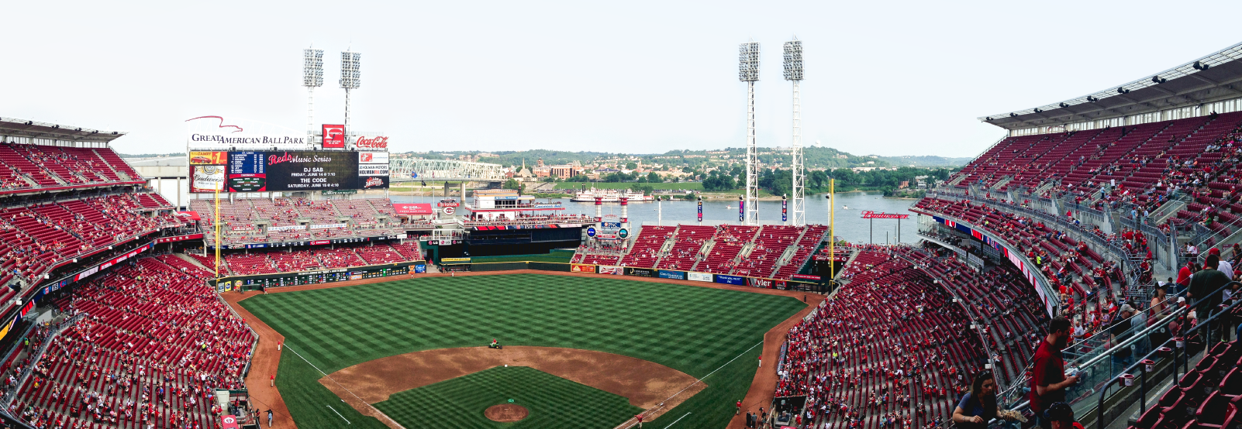
Background
Two chain restaurant franchisers established a Sports Bar Restaurant called, Empire Sports Bar.
Owners would like to have the similar set up as
http://www.bing.com/videos/search?q=First+Time+they+fired+up+the+new+Handle+Bar+in+the+Cincinnati+Reds+Stadium&adlt=strict&view=detail&mid=64925FF53F2062EC9E3664925FF53F2062EC9E36&FORM=VRDGAR
https://www.youtube.com/watch?v=LS0Mm8atMlE
Handle Bar in Cincinnati Reds Stadium

Slide 3

SI searched on the web and found several ATEN VM video wall videos

Slide 4
Layout
Manager Office
管理室
Technical Room
機房
BAR Area
吧台區
Dining Area
用餐區

Slide 5
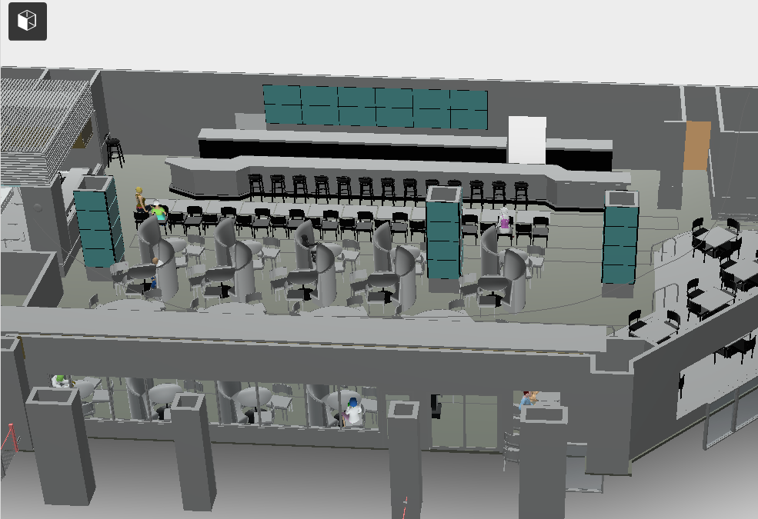
4x3 TV Wall on a column
6x2 TV Wall
4x4 TV Wall on a column
4x3 TV Wall on a column

Slide 6
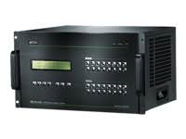
ATEN’s Solution
6x2 TV Wall
VM1600
HDMI Splitter
VM1600
4x4 TV Wall on a column

Slide 7

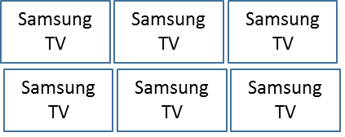
Samsung TV
Samsung TV
Samsung TV
Samsung TV
Samsung TV
Samsung TV
1st VM1600
w/VM7804
w/VM8804
Samsung TV
Samsung TV
Samsung TV
Samsung TV
Samsung TV
Samsung TV
Direct TV box
Direct TV box
Direct TV box
Direct TV box
VE805R
2nd VM1600
w/VM7804
w/VM8514
HDMI Splitter
Samsung TV
Direct TV box
Direct TV box
Samsung TV
Direct TV box
Direct TV box
Samsung TV
Samsung TV

Slide 8
Integrated with VK2100
IR(Suggested)
Samsung TV
Samsung TV
Samsung TV
Samsung TV
Samsung TV
Samsung TV
IR(Suggested)
IR(Suggested)
Samsung TV
Samsung TV
Samsung TV
Samsung TV
Samsung TV
Samsung TV
1st VM1600
w/VM7804
w/VM8804
RS232
(Done)
VK2100
2nd VM1600
w/VM7804
(w/VM7514)
w/VM8514
RS232
(Done)
IR
(Suggested)
Cat
VK236
VE805R
IR through Cat
IR
(Suggested)
IR
Samsung TV
Samsung TV
VK236
IR
Samsung TV
(Suggested)
Samsung TV

Slide 9
Technical Room
VK2100
1st VM1600
2nd VM1600
VM0808HA
was not installed into the production during the visit

Slide 10
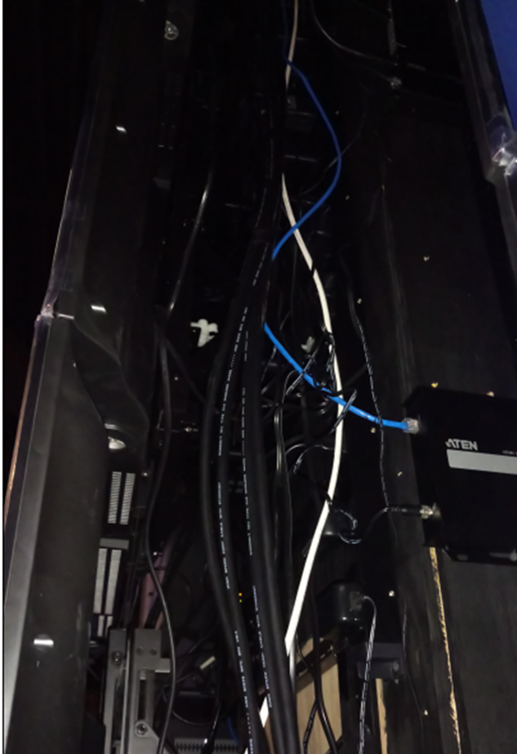
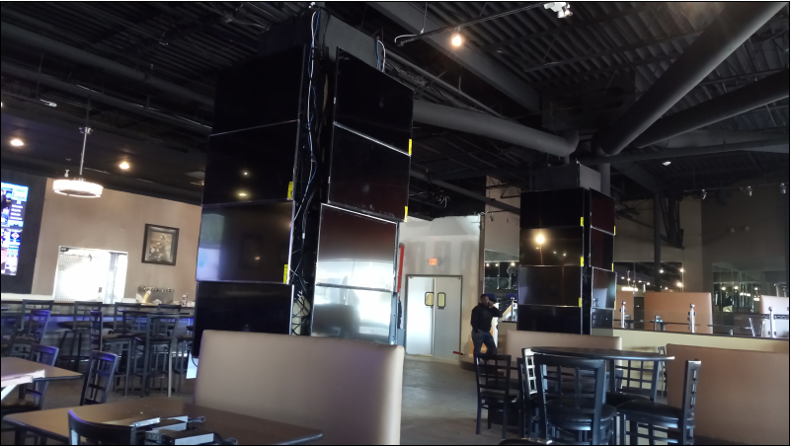
Dinning Area
HDMI Splitter
VE805R
Inside the colume
VE805R

Slide 11
Results at Dinning Area

Slide 12
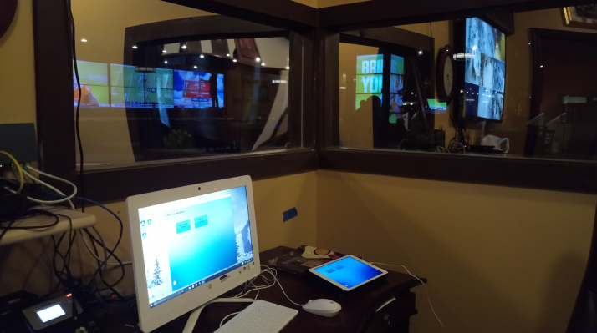
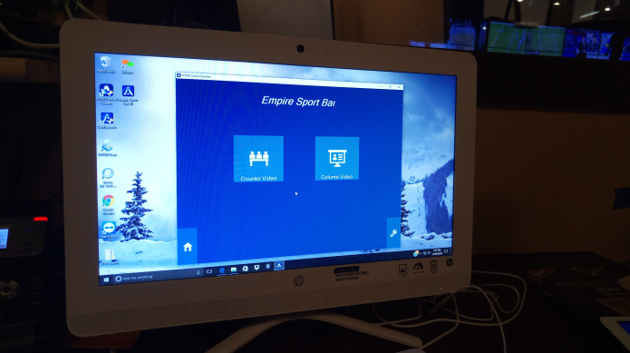
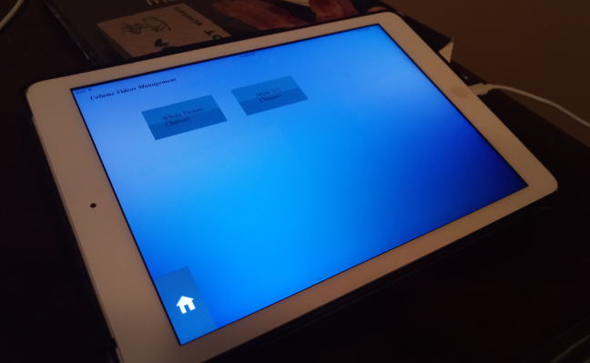
Manager’s Office
Windows to view the status
VK App for PC
VK App for iPad
VK App for PC
VK App for iPad

Slide 13
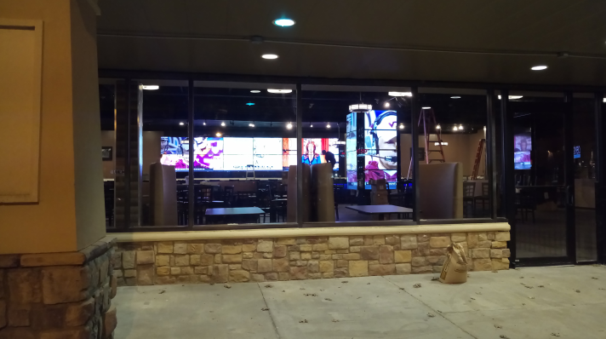
Results from outside of restaurant

Slide 14
Customer’s commands
GUI of VM1600 is easy to use
The result of VideoWall is great
Restaurant owner verbally agreed with success story
Future project possibility
Follow up
VK2100 training (done in Jan)
VE805R lost signal issue(Just got the call last week and working on it)
Official agreement for success story

