Slide 1

VP1920 & VP2730
Go-to-Market Plan
Linda Hung
Marketing Planning Dept

Slide 2
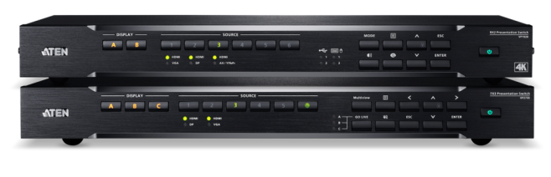
Agenda
Customer Value Proposition of VP2730, VP1920
4P Framework
Promotion Resources
Promotion Suggestions

Slide 3
Customer Value Proposition
VP2730 & VP1920

Slide 4

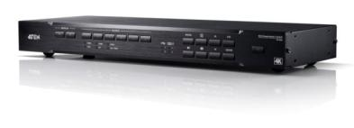
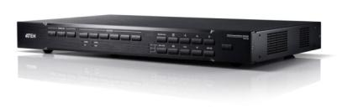
Series Positioning
Multi-format solutions deliver high-quality, multi-format video and audio switching and conversion.
Typical Spaces:
Presentation Meeting Room
Training Room
Classroom
Current Model:
VP1920
VP1000
Core Series
Collaborative presentation solutions facilitate distance-free content sharing with advanced audio.
Typical Spaces:
Conference Room
Boardroom
Lecture Hall
Current Model:
VP2730
VP2000 Collaborative Series

Slide 5
VP2730 – Customer Value Proposition
Target Customers:
DMR/VAR/SI who carry presentation switches for mid-to-large sized meeting environments, including conference rooms, boardrooms, lecture halls.
Value Proposition | 1 ) All Benefits | 2) Favorable Points of Difference | 3) Resonating Focus
Consists of | Supports multi-format 7 Inputs, 3 outputs HDBaseT Extension Wired & Streaming hybrid solution for distance-free collaboration Ultra Seamless Switching with Scaler Multi-view function Audio mixer and phantom-powered Mic support Meeting management features, capture, freeze, chat..etc Compatible with ATEN Control System | POD Wired & Streaming hybrid solution for distance-free collaboration Ultra Seamless Switching with Scaler Intuitive OSD & Web GUI to streamline operation POP Multi-view function Compatible with ATEN Control System | Facilitating Seamless Distance-free Collaboration Wired & Streaming hybrid solution for distance-free collaboration Ultra Seamless Switching with Scaler Easy-to-use Compatible with ATEN Control System
Answers the customer question | End-users request every smooth content switching to ensure meeting efficiency. Remote collaboration is common and essential in the current corporate climate End-users need a flexibility solution for both small-scale or large scale conferencing meeting The system operation is streamlined and easy-to-use | Balanced features and specs to support the popular demand in the market with a reasonable price Wired & Streaming hybrid solution for distance-free collaboration. Ultra Seamless Switching with Scaler Multi-view function | Deliver high-quality meeting experience with reasonable price. ATEN team can live demo and pre-test in ATEN demo rooms to ensure the offering
Requires | VP2730 features ultra seamless switch that is extremely responsive for best meeting experience. Wired & streaming hybrid solution give the flexibility to do the small-scale conferencing meeting or can integrate with advanced conferencing system for large-scale meeting. Also Control System compatible Current feedback highlight: 1. Appreciate the switching speed 2. Multi-view function is very useful | Competitor’s price is relative higher, streaming function usually features in high-end model Some competitors just streaming in or streaming out. Some competitors has wireless presentation solution, but that mainly for local meeting | Equip VP Series in ATEM demo room for demo, testing and training.

Slide 6

VP1920 – Customer Value Proposition
Target Customers:
DMR/VAR/SI who carry presentation switches for small-to-medium sized commercial and educational environments, including presentation meeting rooms, training rooms, classrooms.
Value Proposition | 1 ) All Benefits | 2) Favorable Points of Difference | 3) Resonating Focus
Consists of | Supports wide range analog and digital input interfaces 4K resolution USB control routing for PC and touch panel Matrix & PiP mode Audio embedding & de-embedding | POD USB control routing for PCs and touch panels (KVM switching function) Intuitive OSD to streamline operation POP Supports wide range analog and digital input interfaces 4K resolution | Empowering multi-format 4K presentations USB control switching Intuitive and easy-to-use
Answers the customer question | Need a just right small-to-medium sized solution to support common digital and legacy interfaces. Considering teacher’s demand, USB switch control is essential to classroom application The system operation is streamlined and easy-to-use | VP1920 also extremely suitable for meeting room environment equipped PCs. PC control and integration is much easier than competitors without similar function Classroom application is a hot market that VP1920 can fully support with its wide range interfaces support and KVM switching feature. High CP value | Add a valuable option in the offering to gain more profits. VP1920 can support customers entering into meeting room and classroom related projects easier. ATEN team can live demo and pre-test in ATEN demo rooms to ensure the offering
Requires | Specially suitable for Classroom Application with USB control routing support. | Less competitor features USB control switching functions. Classroom application is a hot search topic online. Competitive pricing | Equip VP Series in ATEM demo room for demo, testing and training. Competitive pricing strategy

Slide 7
4P Framework &
Promotion Resources & Suggestions

Slide 8

4P at a Glance
Series | Collaborative Series | Core Series
Model | 7 x 3 Seamless Presentation Matrix Switch with Scaler, Streaming, Audio Mixer and HDBaseT VP2730 | 9 x 2 4K Presentation Matrix Switch VP1920
Product | Facilitating Seamless Distance-free Collaboration Wired & Streaming hybrid solution for distance-free collaboration Ultra Seamless Switching with Scaler Multi-view Compatible with ATEN Control System | Empowering multi-format 4K presentations USB control routing for PCs and touch panels Supports wide range analog and digital input interfaces 4K resolution Matrix & PiP Mode
Price | USD2500 | USD995
Promotion
Place | 1. DMR/VAR/SIs 2. Marketplace, etailer
Public Relations
Roadshows /Events
Press release
SI/Disty review video/article
Media interview
Pull-up banner
Brochure
Video (2nd wave)
Online Marketing
Landing page
Online brochure
eDM
Series/Individual banners
Video (2nd wave)
SEO/SEM
Keyword pack
Social posts
Linkedin Campaign

Slide 9
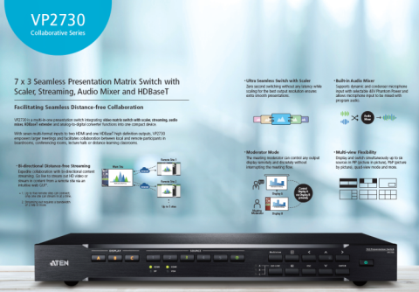

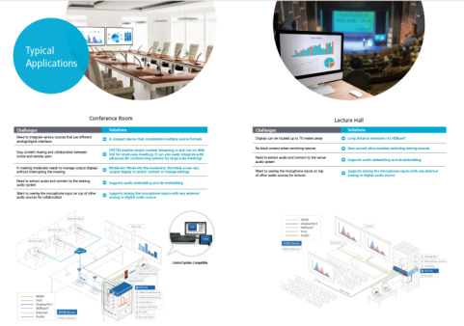
Promotion Material – Series Brochure
Content Highlights:
Key Features
Typical Applications & Diagram
Series Comparison

Slide 10
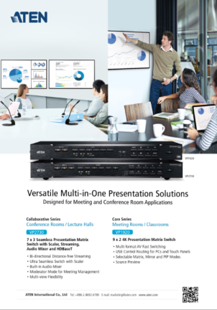
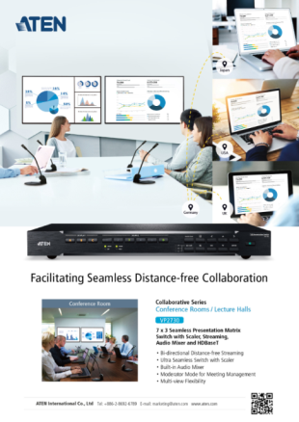
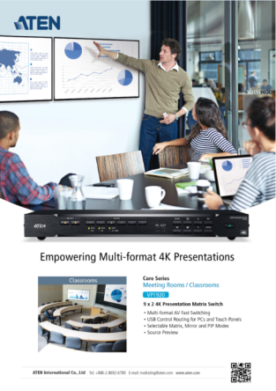
Promotion Material – ADs
Series AD
VP2730 AD
VP1920 AD

Slide 11

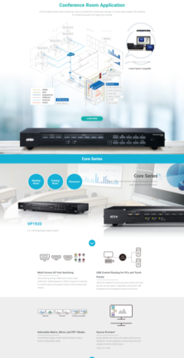
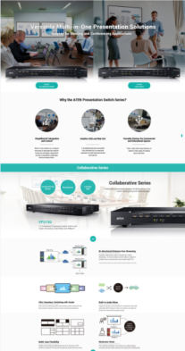
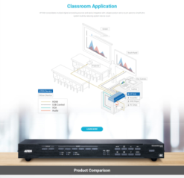


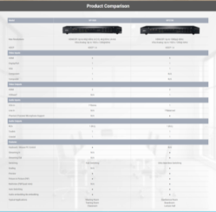
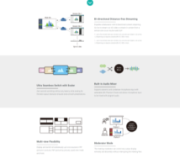
Promotion Material – Landing Page & eDM

Slide 12

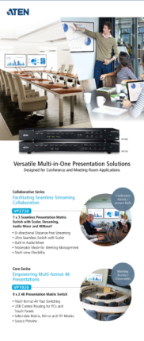

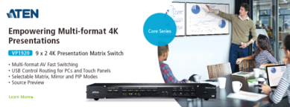
Promotion Material – Online & Pull-up Banner
Series Pull-up Banner
Series Banner
VP2730 Banner
VP1920 Banner

Slide 13
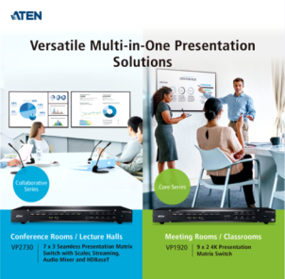
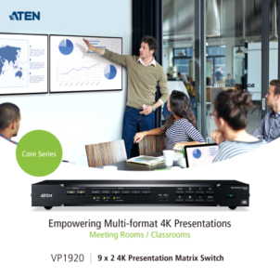

Promotion Material – Keyword & Social Posts
Keyword Pack

Slide 14

Promotion Suggestions
Enhance PR and media exposures to spread out the exposures.
Highly encourage to approach SI or disty to do local peer review article and video.
Equip VP Series into ATEN Showroom and well-leverage the venue to do customer training/demo
HQ will supply the product video around Nov/E

