Slide 1

VM0202H
2x2 4K HDMI Matrix Switch
Applied Video Product Department
Sophia Lai
2017, Mar

Slide 2
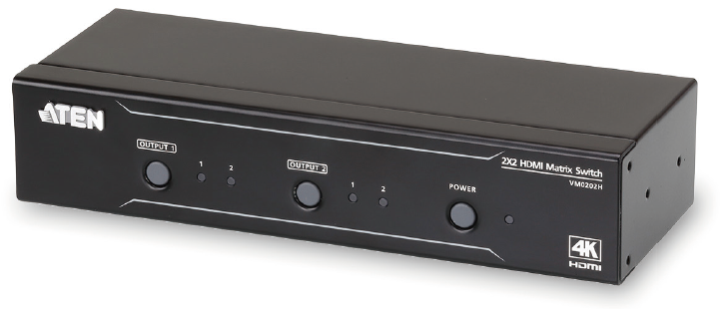
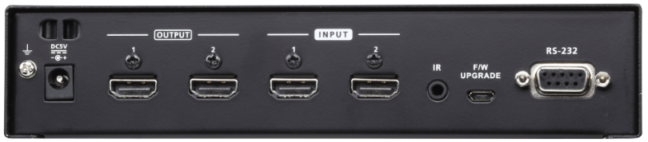
VM0202H – 2x2 4K HDMI Matrix Switch
The VM0202H matrix switch provides high performance routing of 2 HDMI video sources to any 2 HDMI displays.
Supports video signals up to 4K@30 (4:4:4), 4K@60 (4:2:0)
GND / DC
HDMI In / Out
IR / FW / RS232
2

Slide 3


4K ULTRA HD offers a superb image
With four times the resolution of Full HD, you will see the finest details portrayed with the utmost clarity
  Supports 4K resolutions of UHD (3840x2160) and DCI (4096x2160) with refresh rates of 30 Hz (4:4:4) and 60 Hz (4:2:0)
Full HD

Slide 4

Applications
Any 2 HDMI displays (Individual content display)
Easy to switch among 2 HDMI Sources
such as in bank, post office, classroom, … etc.
Source Switching

Slide 5
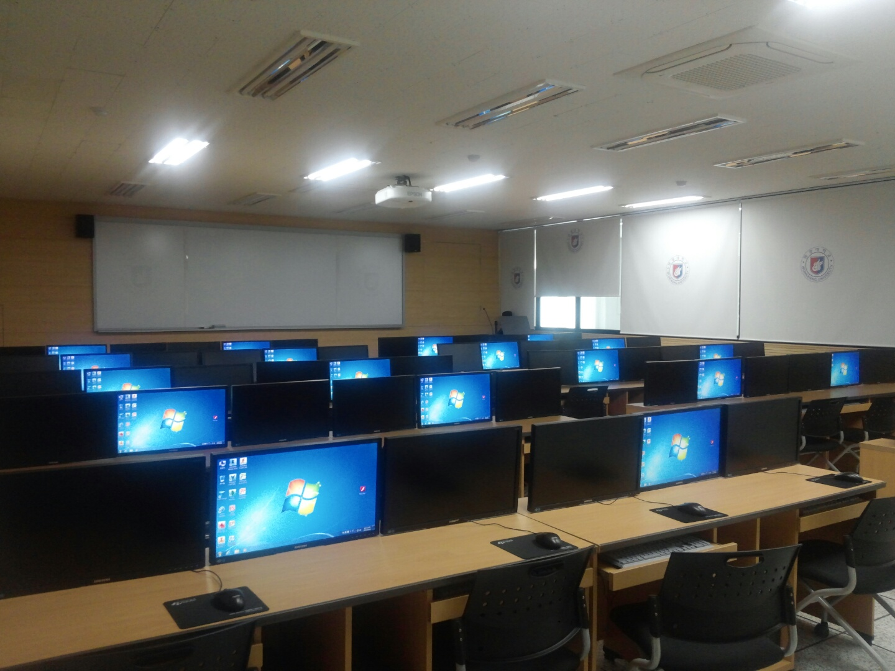




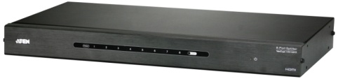

Scenario in classroom
VM0202H
Video Matrix
VS182A
2-Port Splitter
VS0108HA
8-Port Splitter

Slide 6
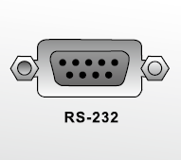
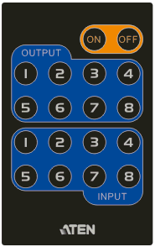



What is VM0202H ?
Product Description：2x2 4K HDMI Matrix Switch
MSRP：US$TBD
Features:
  Connects 2 HDMI sources to any 2 HDMI displays
  Up to 4096x2160/3840x2160@60Hz (4:2:0); 4096x2160/3840x2160@30Hz (4:4:4);
  HDCP 1.4 Compatible
  Multiple Control Methods- system management via front panel push buttons, IR remote and RS- 232 control
  Supports ATEN’s LockPro™ HDMI cable lock for secure HDMI cable connections
  EDID Expert™ – selects optimum EDID settings for smooth power-up, high-quality display and use of the best video resolution across different screens
4K
IR Receiver
Multiple Control Methods for easily switch
Superior video quality
Up to UHD 4K
ATEN EDID Expert
To provide better compatibility

Slide 7
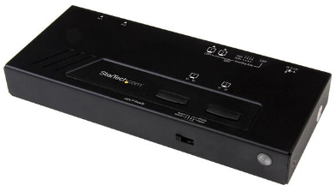
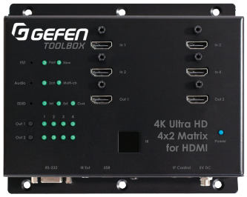
Comparison Table
Company | Aten | StarTech | Gefen
Category | 2x2 4K HDMI Matrix | 2x2 4K HDMI Matrix | 4x2 4K HDMI Matrix
Model Name | VM0202H | VS222HD4K | GTB-HD4K2K-442-BLK
Picture
MSRP | US$ | US$199.00 | US$499.00
Street price
In x Out | 2x2 | 2x2 | 4x2
Standard Compliant | HDCP1.4 | HDCP1.4 | HDCP1.4
Resolution | 4K@ 60Hz 4:2:0/ @30Hz 4:4:4 | 4K @ 30 Hz | 4K@ 60Hz 4:2:0/ @30Hz 4:4:4
RS232 | Yes | Yes | Yes
IR | Yes | Yes | Yes
Ethernet | No | No | Yes

Slide 8


